Slide 1
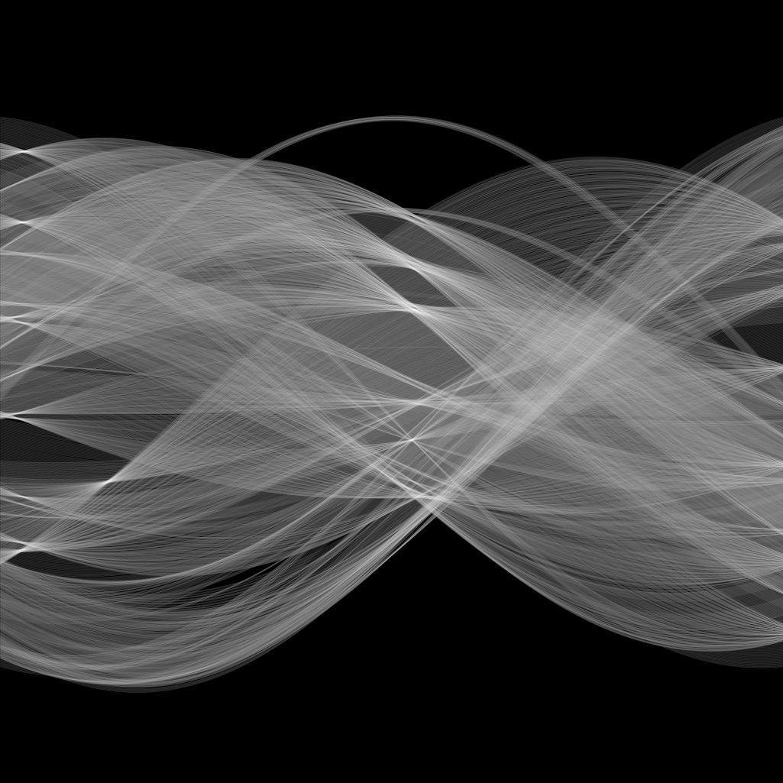

Curve fitting
Yoni Chechik
www.AIisMath.com

Slide 2
References
http://szeliski.org/Book/
http://www.cs.cornell.edu/courses/cs5670/2019sp/lectures/lectures.html
http://www.cs.cmu.edu/~16385/

Slide 3
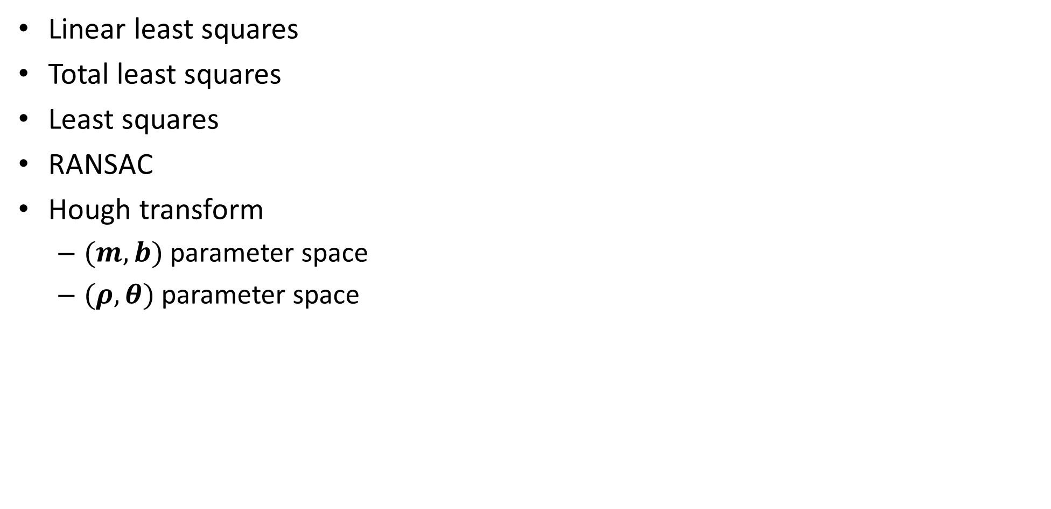
TOC
Linear least squares
Total least squares
Least squares
RANSAC
Hough transform
$(m,b)$ parameter space
$(ρ,θ)$ parameter space

Slide 4

Some motivation
What you think about when you hear “line/curve fitting”

Slide 5
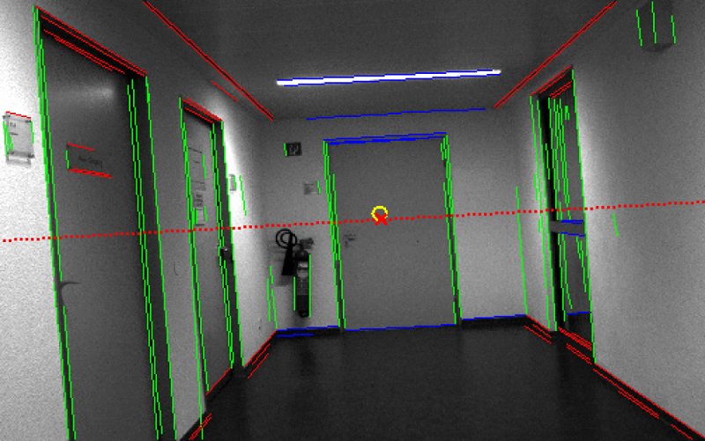
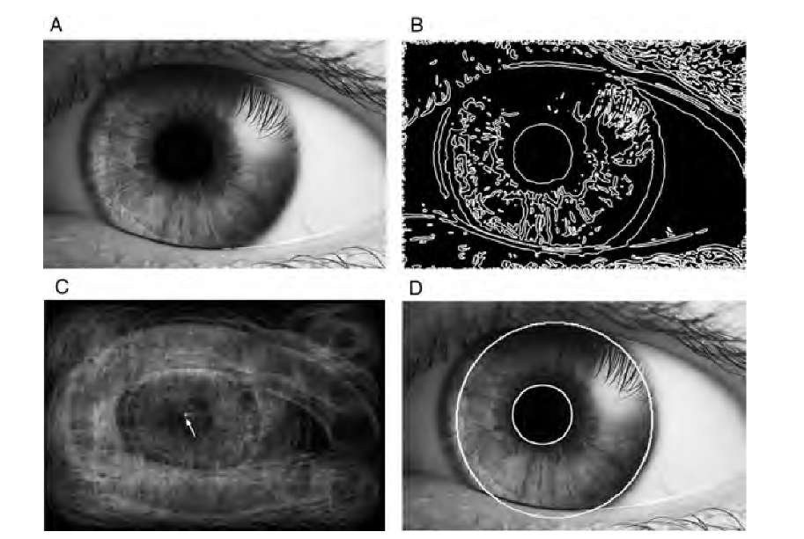
Some motivation
Autonomous Vehicles
(lane line detection)
Bio-medical engineering
(blood vessel counting)
Biology
(earthworm contours)
Robotics
(scene understanding)
Psychology/ Human computer interaction
(eye tracking)

Slide 6
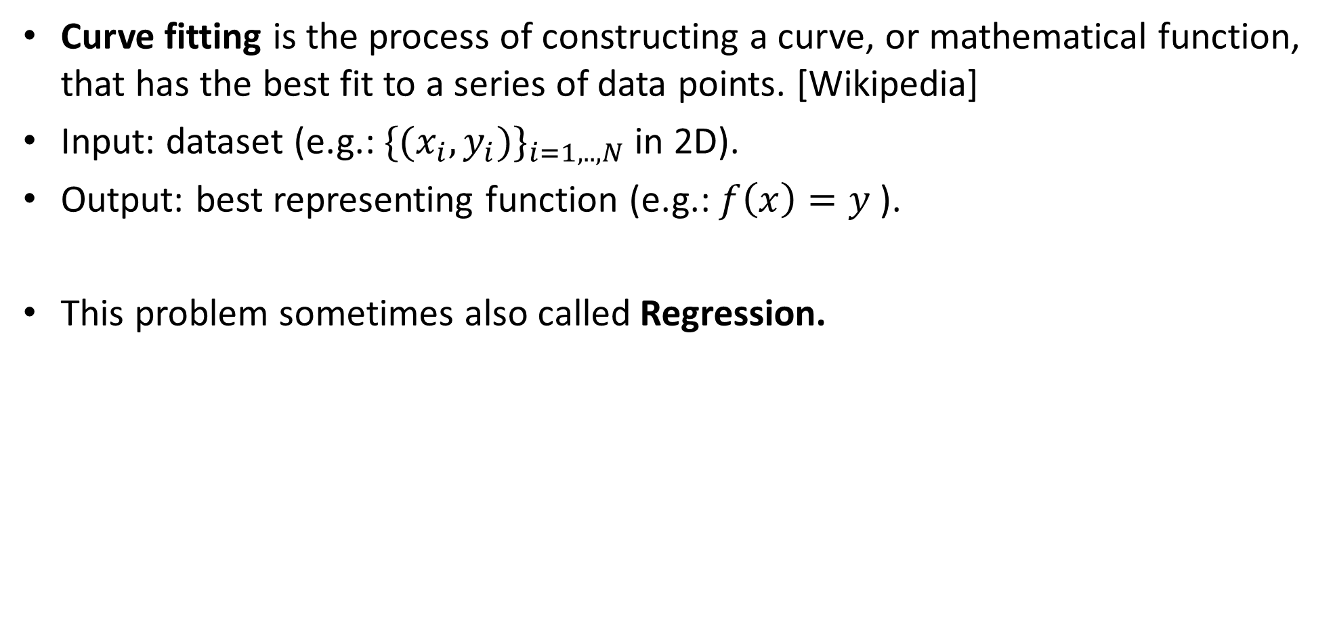
What is curve fitting
Curve fitting is the process of constructing a curve, or mathematical function, that has the best fit to a series of data points. [Wikipedia]
Input: dataset (e.g.: ${\{(x_{i},y_{i})\}}_{i=1,..,N}$in 2D).
Output: best representing function (e.g.: $f\left(x\right)=y$ ).
This problem sometimes also called Regression.

Slide 7
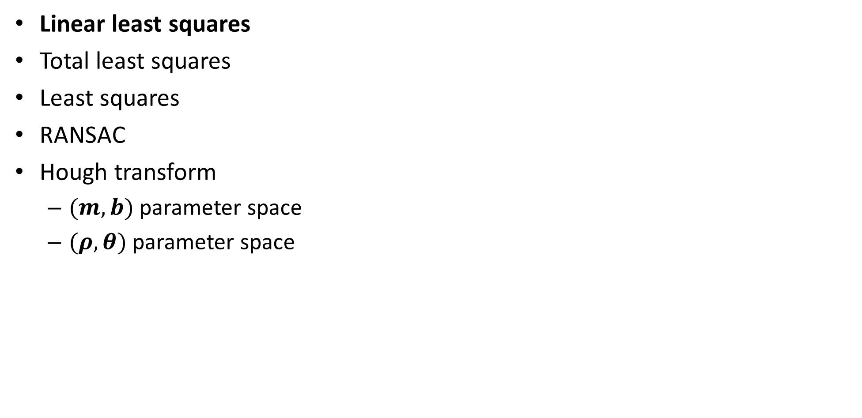
TOC
Linear least squares
Total least squares
Least squares
RANSAC
Hough transform
$(m,b)$ parameter space
$(ρ,θ)$ parameter space

Slide 8
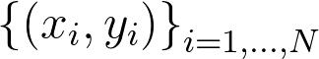
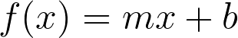
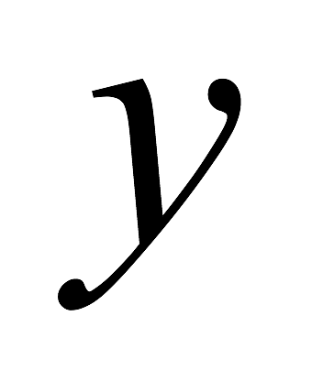
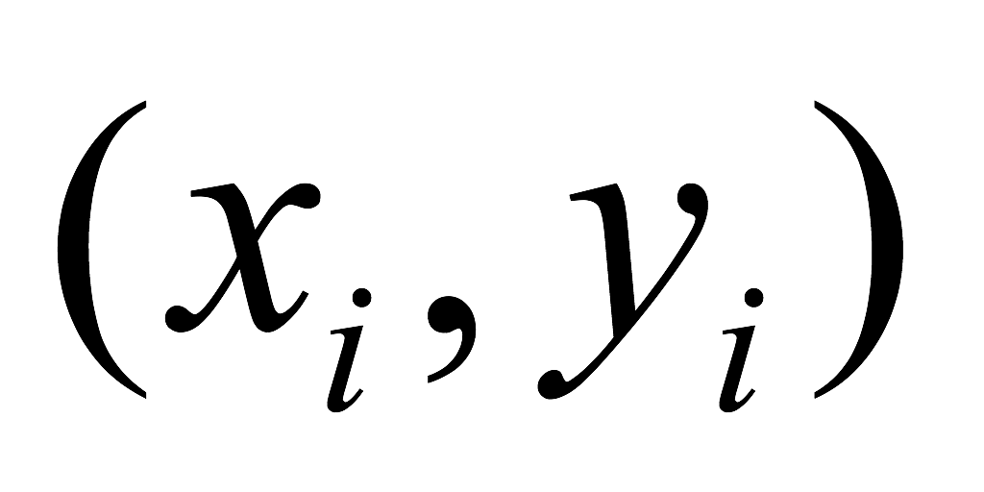
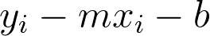

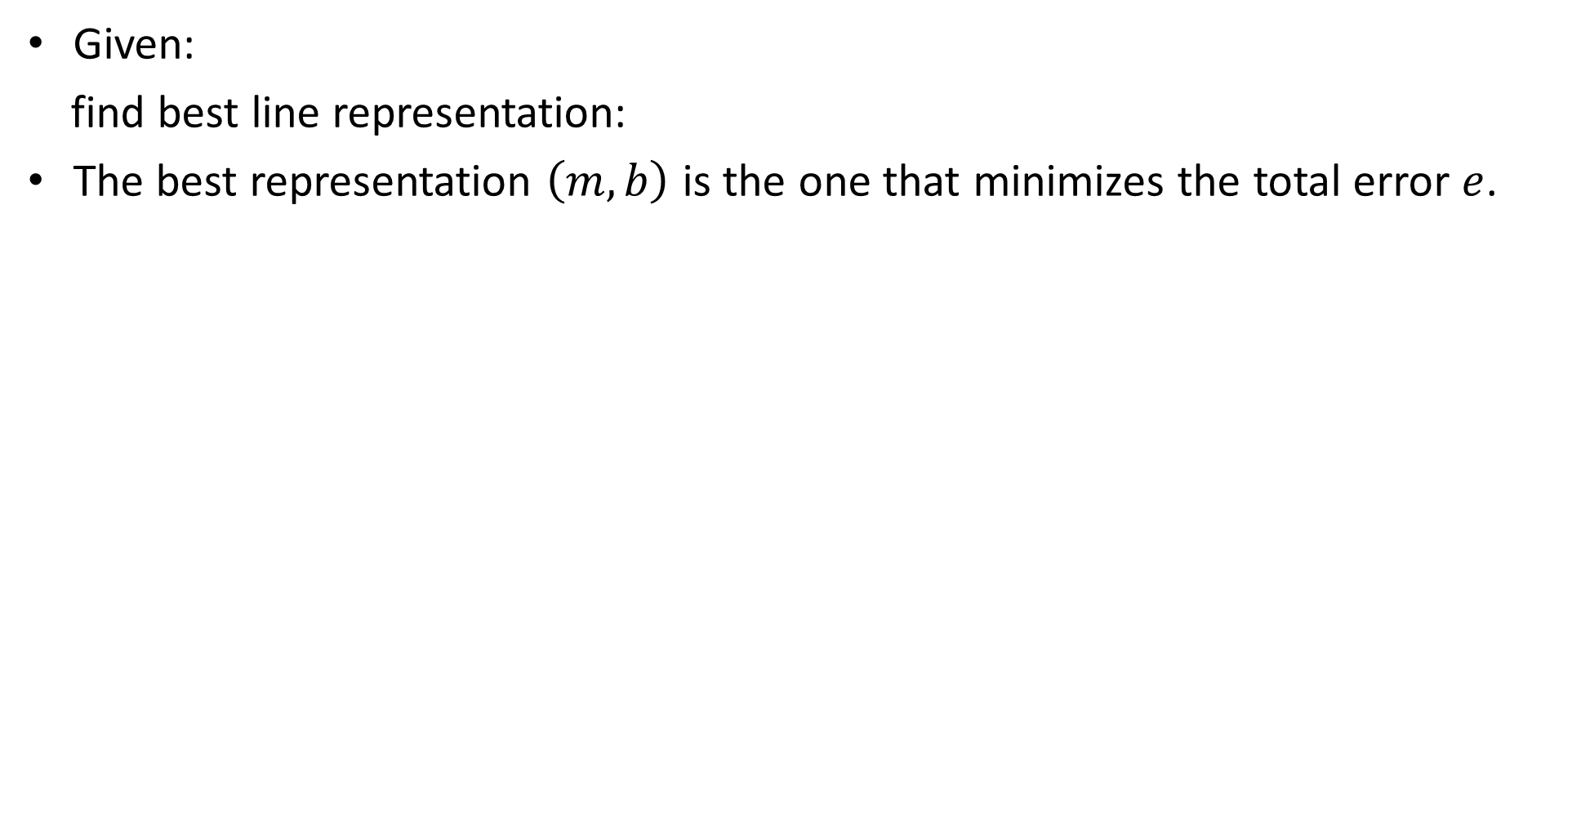
Line fitting- Line fitting- linear least squares (LS): step by step example
Given:
find best line representation:
The best representation $\left(m,b\right)$ is the one that minimizes the total error $e$.
Notes:
\left \{ (x_i,y_i)\right \}_{i=1,...,N}
e=\frac{1}{N}\sum_{i=1}^{N} (y_i-f(x_i))^2
f(x)=mx+b
y_i-mx_i-b
e=\frac{1}{N}\sum_{i=1}^{N} (y_i-mx_i-b)^2

Slide 9
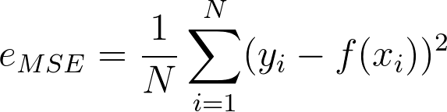
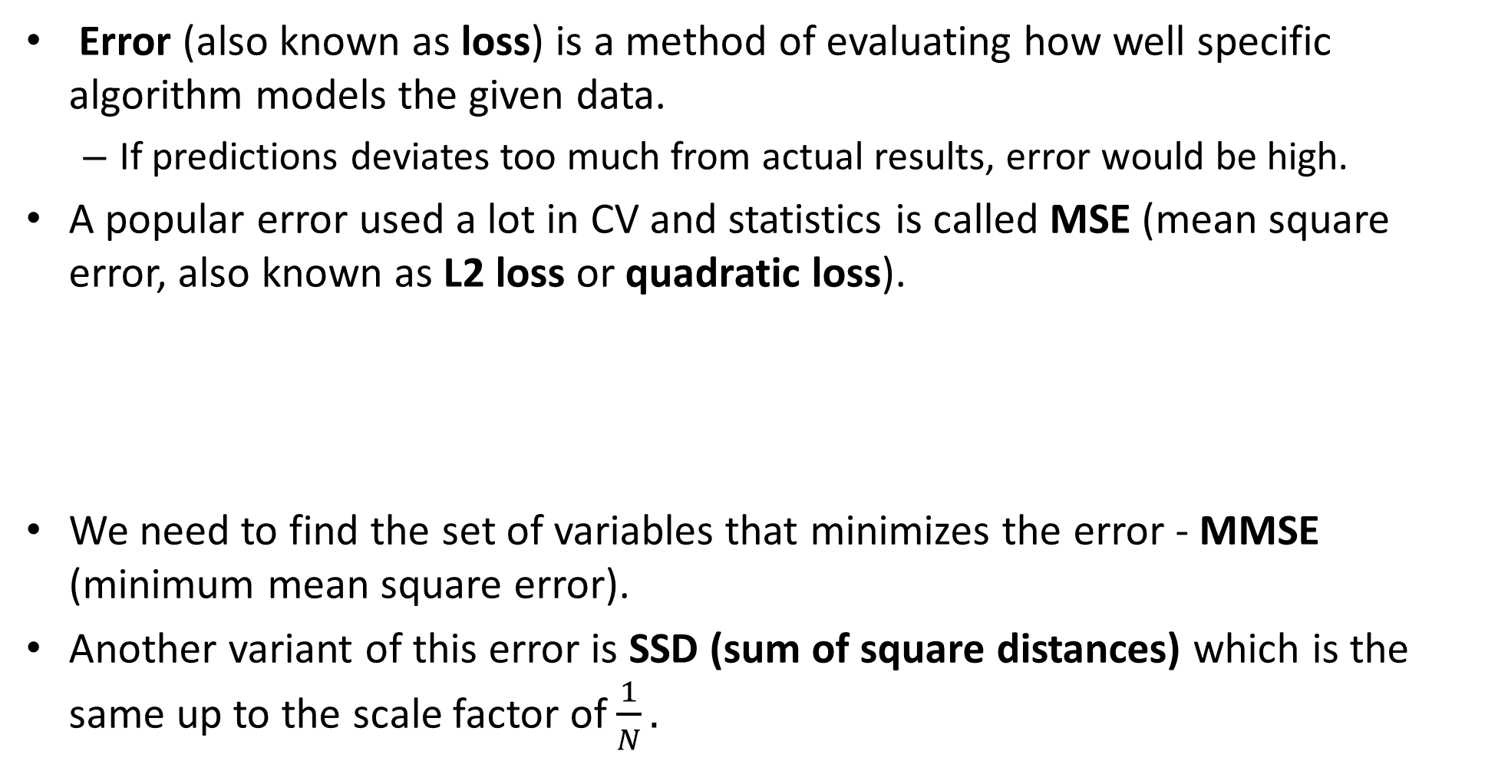
Side note: error / loss
Error (also known as loss) is a method of evaluating how well specific algorithm models the given data.
If predictions deviates too much from actual results, error would be high.
A popular error used a lot in CV and statistics is called MSE (mean square error, also known as L2 loss or quadratic loss).
We need to find the set of variables that minimizes the error - MMSE (minimum mean square error).
Another variant of this error is SSD (sum of square distances) which is the same up to the scale factor of $\frac{1}{N}.$

Slide 10
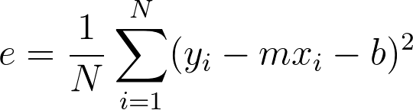
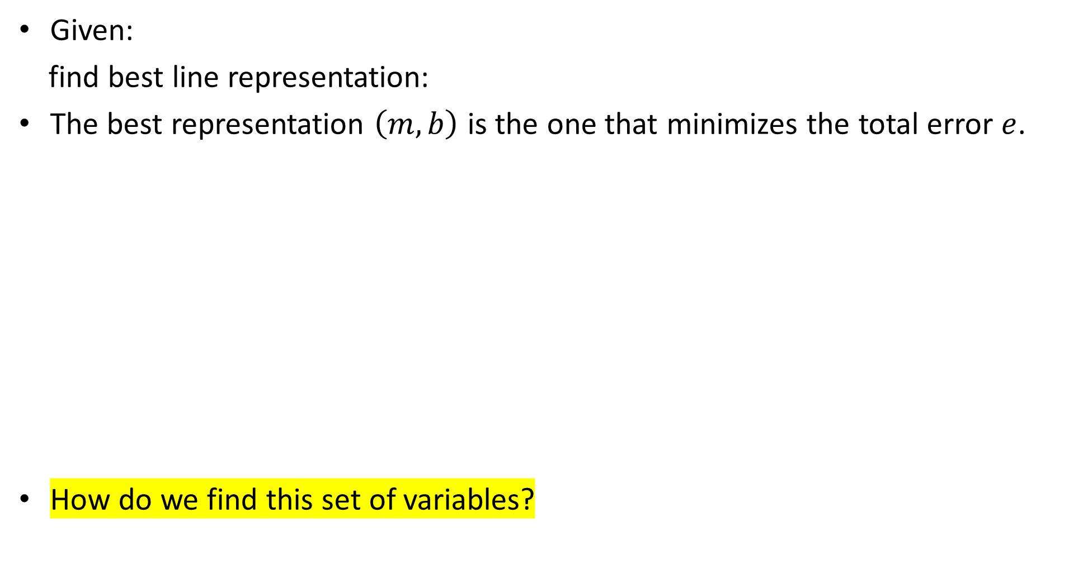
Line fitting- Line fitting- linear least squares (LS): step by step example
Given:
find best line representation:
The best representation $\left(m,b\right)$ is the one that minimizes the total error $e$.
How do we find this set of variables?
Notes:
\left \{ (x_i,y_i)\right \}_{i=1,...,N}
e=\frac{1}{N}\sum_{i=1}^{N} (y_i-f(x_i))^2
f(x)=mx+b
y_i-mx_i-b
e=\frac{1}{N}\sum_{i=1}^{N} (y_i-mx_i-b)^2

Slide 11
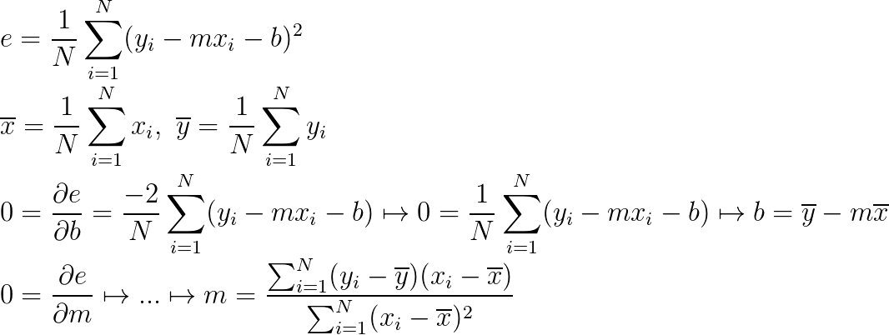
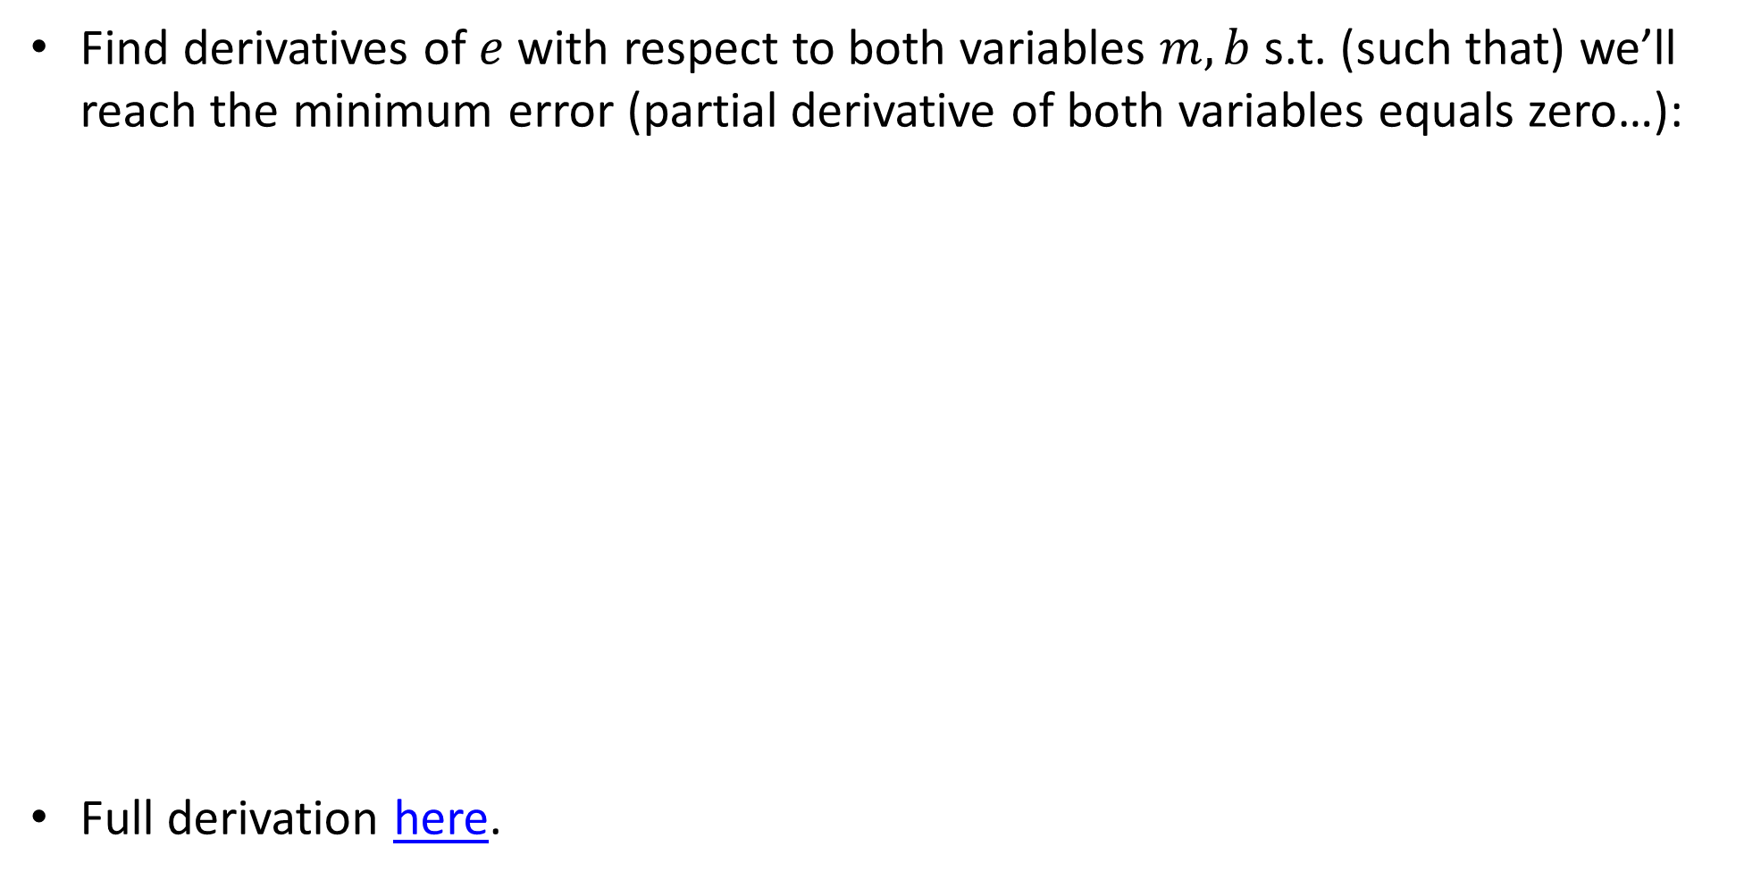
Line fitting- Line fitting- linear least squares (LS): step by step example
Find derivatives of $e$ with respect to both variables $m,b$s.t. (such that) we’ll reach the minimum error (partial derivative of both variables equals zero…):
Full derivation here.
Notes:
\\
e =\frac{1}{N}\sum_{i=1}^{N} (y_i-mx_i-b)^2
\\
\overline{x}=\frac{1}{N}\sum_{i=1}^{N} x_i , \,\, \overline{y}=\frac{1}{N}\sum_{i=1}^{N} y_i
\\
0=\frac{\partial e}{\partial b} =\frac{-2}{N}\sum_{i=1}^{N} (y_i-mx_i-b) \mapsto 0 =\frac{1}{N}\sum_{i=1}^{N} (y_i-mx_i-b)\mapsto b=\overline{y}-m\overline{x}
\\
0=\frac{\partial e}{\partial m} \mapsto ...\mapsto m = \frac{\sum_{i=1}^{N} (y_i-\overline{y})(x_i-\overline{x}) }{\sum_{i=1}^{N}(x_i-\overline{x}) ^2}

Slide 12
Line fitting- linear least squares (LS): step by step example
Find derivatives of $e$ with respect to both variables $m,b$s.t. (such that) we’ll reach the minimum error (partial derivative of both variables equals zero…):
Full derivation here.

Slide 13
Line fitting- linear least squares (LS): step by step example
Find derivatives of $e$ with respect to both variables $m,b$s.t. (such that) we’ll reach the minimum error (partial derivative of both variables equals zero…):
Full derivation here.

Slide 14
Line fitting- linear least squares (LS): step by step example
Find derivatives of $e$ with respect to both variables $m,b$s.t. (such that) we’ll reach the minimum error (partial derivative of both variables equals zero…):
Full derivation here.

Slide 15
Line fitting- linear least squares (LS): step by step example
Find derivatives of $e$ with respect to both variables $m,b$s.t. (such that) we’ll reach the minimum error (partial derivative of both variables equals zero…):
Full derivation here.

Slide 16
Line fitting- linear least squares (LS): step by step example
Find derivatives of $e$ with respect to both variables $m,b$s.t. (such that) we’ll reach the minimum error (partial derivative of both variables equals zero…):
Full derivation here.

Slide 17
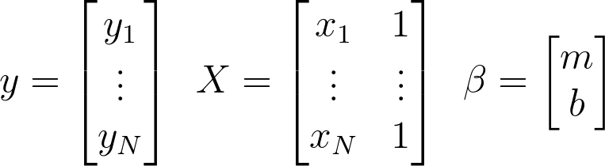
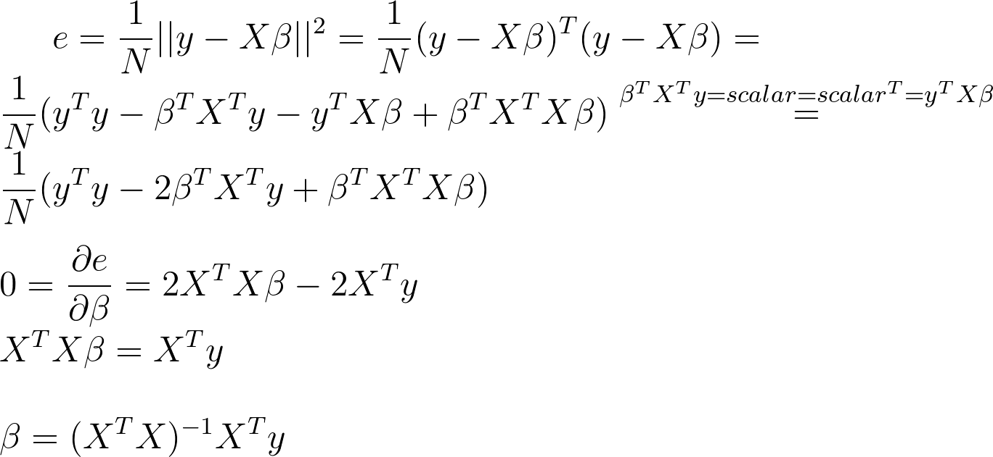
Line fitting - Line fitting - linear LS in matrix form
Notes:
y =
\begin{bmatrix}
y_1\\
\vdots\\
y_N
\end{bmatrix}
\,\,\,
X=
\begin{bmatrix}
x_1&1\\
\vdots&\vdots\\
x_N&1
\end{bmatrix}
\,\,\,
\beta=
\begin{bmatrix}
m\\
b
\end{bmatrix}
e = \frac{1}{N}||y-X\beta||^2 = \frac{1}{N}(y-X\beta)^T(y-X\beta)=\\
\frac{1}{N}(y^Ty-\beta^TX^Ty-y^TX\beta+\beta^TX^TX\beta)\stackrel{\beta^TX^Ty=scalar=scalar^T=y^TX\beta}{=}\\
\frac{1}{N}(y^Ty-2\beta^TX^Ty+\beta^TX^TX\beta)\\
\\
0=\frac{\partial e}{\partial \beta}=2X^TX\beta-2X^Ty\\
X^TX\beta=X^Ty\\
\\
\beta = (X^TX)^{-1}X^Ty

Slide 18
Line fitting - linear LS in matrix form
Notes:
y =
\begin{bmatrix}
y_1\\
\vdots\\
y_N
\end{bmatrix}
\,\,\,
X=
\begin{bmatrix}
x_1&1\\
\vdots&\vdots\\
x_N&1
\end{bmatrix}
\,\,\,
\beta=
\begin{bmatrix}
m\\
b
\end{bmatrix}
e = \frac{1}{N}||y-X\beta||^2 = \frac{1}{N}(y-X\beta)^T(y-X\beta)=\\
\frac{1}{N}(y^Ty-\beta^TX^Ty-y^TX\beta+\beta^TX^TX\beta)\stackrel{\beta^TX^Ty=scalar=scalar^T=y^TX\beta}{=}\\
\frac{1}{N}(y^Ty-2\beta^TX^Ty+\beta^TX^TX\beta)\\
\\
0=\frac{\partial e}{\partial \beta}=2X^TX\beta-2X^Ty\\
X^TX\beta=X^Ty\\
\\
\beta = (X^TX)^{-1}X^Ty

Slide 19
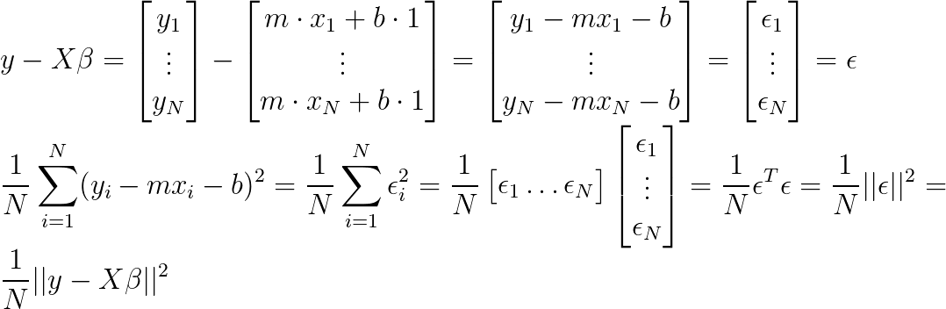
Line fitting - linear LS in matrix form
Notes:
\\
y-X\beta=
\begin{bmatrix}
y_1\\
\vdots\\
y_N
\end{bmatrix}
-
\begin{bmatrix}
m\cdot x_1+b\cdot 1\\
\vdots\\
m\cdot x_N+b\cdot 1
\end{bmatrix}
=
\begin{bmatrix}
y_1-mx_1-b\\
\vdots\\
y_N-mx_N-b
\end{bmatrix}
=
\begin{bmatrix}
\epsilon_1\\
\vdots\\
\epsilon_N
\end{bmatrix}
=
\epsilon
\\
\frac{1}{N}\sum_{i=1}^N(y_i-mx_i-b)^2=
\frac{1}{N}\sum_{i=1}^N\epsilon_i^2=
\frac{1}{N}\begin{bmatrix}
\epsilon_1 \hdots \epsilon_N
\end{bmatrix}
\begin{bmatrix}
\epsilon_1\\
\vdots\\
\epsilon_N
\end{bmatrix}
=
\frac{1}{N}\epsilon^T\epsilon
=
\frac{1}{N}||\epsilon||^2
=
\frac{1}{N}||y-X\beta||^2

Slide 20
Line fitting - linear LS in matrix form
Notes:
\\
y-X\beta=
\begin{bmatrix}
y_1\\
\vdots\\
y_N
\end{bmatrix}
-
\begin{bmatrix}
m\cdot x_1+b\cdot 1\\
\vdots\\
m\cdot x_N+b\cdot 1
\end{bmatrix}
=
\begin{bmatrix}
y_1-mx_1-b\\
\vdots\\
y_N-mx_N-b
\end{bmatrix}
=
\begin{bmatrix}
e_1\\
\vdots\\
e_N
\end{bmatrix}
=
e
\\
\sum_{i=1}^N(y_i-mx_i-b)^2=
\sum_{i=1}^Ne_i^2=
\begin{bmatrix}
e_1 \hdots e_N
\end{bmatrix}
\begin{bmatrix}
e_1\\
\vdots\\
e_N
\end{bmatrix}
=
e^Te
=
||e||^2
=
||y-X\beta||^2

Slide 21
Line fitting - linear LS in matrix form
Notes:
y =
\begin{bmatrix}
y_1\\
\vdots\\
y_N
\end{bmatrix}
\,\,\,
X=
\begin{bmatrix}
x_1&1\\
\vdots&\vdots\\
x_N&1
\end{bmatrix}
\,\,\,
\beta=
\begin{bmatrix}
m\\
b
\end{bmatrix}
e = \frac{1}{N}||y-X\beta||^2 = \frac{1}{N}(y-X\beta)^T(y-X\beta)=\\
\frac{1}{N}(y^Ty-\beta^TX^Ty-y^TX\beta+\beta^TX^TX\beta)\stackrel{\beta^TX^Ty=scalar=scalar^T=y^TX\beta}{=}\\
\frac{1}{N}(y^Ty-2\beta^TX^Ty+\beta^TX^TX\beta)\\
\\
0=\frac{\partial e}{\partial \beta}=2X^TX\beta-2X^Ty\\
X^TX\beta=X^Ty\\
\\
\beta = (X^TX)^{-1}X^Ty

Slide 22
Line fitting - linear LS in matrix form
Notes:
y =
\begin{bmatrix}
y_1\\
\vdots\\
y_N
\end{bmatrix}
\,\,\,
X=
\begin{bmatrix}
x_1&1\\
\vdots&\vdots\\
x_N&1
\end{bmatrix}
\,\,\,
\beta=
\begin{bmatrix}
m\\
b
\end{bmatrix}
e = \frac{1}{N}||y-X\beta||^2 = \frac{1}{N}(y-X\beta)^T(y-X\beta)=\\
\frac{1}{N}(y^Ty-\beta^TX^Ty-y^TX\beta+\beta^TX^TX\beta)\stackrel{\beta^TX^Ty=scalar=scalar^T=y^TX\beta}{=}\\
\frac{1}{N}(y^Ty-2\beta^TX^Ty+\beta^TX^TX\beta)\\
\\
0=\frac{\partial e}{\partial \beta}=2X^TX\beta-2X^Ty\\
X^TX\beta=X^Ty\\
\\
\beta = (X^TX)^{-1}X^Ty

Slide 23
Line fitting - linear LS in matrix form
Notes:
y =
\begin{bmatrix}
y_1\\
\vdots\\
y_N
\end{bmatrix}
\,\,\,
X=
\begin{bmatrix}
x_1&1\\
\vdots&\vdots\\
x_N&1
\end{bmatrix}
\,\,\,
\beta=
\begin{bmatrix}
m\\
b
\end{bmatrix}
e = \frac{1}{N}||y-X\beta||^2 = \frac{1}{N}(y-X\beta)^T(y-X\beta)=\\
\frac{1}{N}(y^Ty-\beta^TX^Ty-y^TX\beta+\beta^TX^TX\beta)\stackrel{\beta^TX^Ty=scalar=scalar^T=y^TX\beta}{=}\\
\frac{1}{N}(y^Ty-2\beta^TX^Ty+\beta^TX^TX\beta)\\
\\
0=\frac{\partial e}{\partial \beta}=2X^TX\beta-2X^Ty\\
X^TX\beta=X^Ty\\
\\
\beta = (X^TX)^{-1}X^Ty

Slide 24
Line fitting - linear LS in matrix form
Notes:
y =
\begin{bmatrix}
y_1\\
\vdots\\
y_N
\end{bmatrix}
\,\,\,
X=
\begin{bmatrix}
x_1&1\\
\vdots&\vdots\\
x_N&1
\end{bmatrix}
\,\,\,
\beta=
\begin{bmatrix}
m\\
b
\end{bmatrix}
e = \frac{1}{N}||y-X\beta||^2 = \frac{1}{N}(y-X\beta)^T(y-X\beta)=\\
\frac{1}{N}(y^Ty-\beta^TX^Ty-y^TX\beta+\beta^TX^TX\beta)\stackrel{\beta^TX^Ty=scalar=scalar^T=y^TX\beta}{=}\\
\frac{1}{N}(y^Ty-2\beta^TX^Ty+\beta^TX^TX\beta)\\
\\
0=\frac{\partial e}{\partial \beta}=2X^TX\beta-2X^Ty\\
X^TX\beta=X^Ty\\
\\
\beta = (X^TX)^{-1}X^Ty

Slide 25
Line fitting - linear LS in matrix form
Notes:
y =
\begin{bmatrix}
y_1\\
\vdots\\
y_N
\end{bmatrix}
\,\,\,
X=
\begin{bmatrix}
x_1&1\\
\vdots&\vdots\\
x_N&1
\end{bmatrix}
\,\,\,
\beta=
\begin{bmatrix}
m\\
b
\end{bmatrix}
e = \frac{1}{N}||y-X\beta||^2 = \frac{1}{N}(y-X\beta)^T(y-X\beta)=\\
\frac{1}{N}(y^Ty-\beta^TX^Ty-y^TX\beta+\beta^TX^TX\beta)\stackrel{\beta^TX^Ty=scalar=scalar^T=y^TX\beta}{=}\\
\frac{1}{N}(y^Ty-2\beta^TX^Ty+\beta^TX^TX\beta)\\
\\
0=\frac{\partial e}{\partial \beta}=2X^TX\beta-2X^Ty\\
X^TX\beta=X^Ty\\
\\
\beta = (X^TX)^{-1}X^Ty

Slide 26
Line fitting - linear LS in matrix form
Notes:
y =
\begin{bmatrix}
y_1\\
\vdots\\
y_N
\end{bmatrix}
\,\,\,
X=
\begin{bmatrix}
x_1&1\\
\vdots&\vdots\\
x_N&1
\end{bmatrix}
\,\,\,
\beta=
\begin{bmatrix}
m\\
b
\end{bmatrix}
e = \frac{1}{N}||y-X\beta||^2 = \frac{1}{N}(y-X\beta)^T(y-X\beta)=\\
\frac{1}{N}(y^Ty-\beta^TX^Ty-y^TX\beta+\beta^TX^TX\beta)\stackrel{\beta^TX^Ty=scalar=scalar^T=y^TX\beta}{=}\\
\frac{1}{N}(y^Ty-2\beta^TX^Ty+\beta^TX^TX\beta)\\
\\
0=\frac{\partial e}{\partial \beta}=2X^TX\beta-2X^Ty\\
X^TX\beta=X^Ty\\
\\
\beta = (X^TX)^{-1}X^Ty

Slide 27
Line fitting - linear LS in matrix form
Notes:
y =
\begin{bmatrix}
y_1\\
\vdots\\
y_N
\end{bmatrix}
\,\,\,
X=
\begin{bmatrix}
x_1&1\\
\vdots&\vdots\\
x_N&1
\end{bmatrix}
\,\,\,
\beta=
\begin{bmatrix}
m\\
b
\end{bmatrix}
e = \frac{1}{N}||y-X\beta||^2 = \frac{1}{N}(y-X\beta)^T(y-X\beta)=\\
\frac{1}{N}(y^Ty-\beta^TX^Ty-y^TX\beta+\beta^TX^TX\beta)\stackrel{\beta^TX^Ty=scalar=scalar^T=y^TX\beta}{=}\\
\frac{1}{N}(y^Ty-2\beta^TX^Ty+\beta^TX^TX\beta)\\
\\
0=\frac{\partial e}{\partial \beta}=2X^TX\beta-2X^Ty\\
X^TX\beta=X^Ty\\
\\
\beta = (X^TX)^{-1}X^Ty

Slide 28
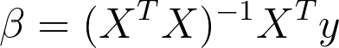
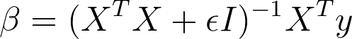
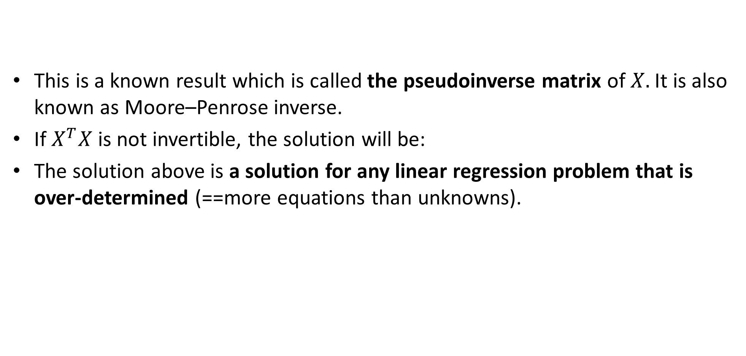
Side note: pseudoinverse
This is a known result which is called the pseudoinverse matrix of$X.$ It is also known as Moore–Penrose inverse.
If $X^{T}X$is not invertible, the solution will be:
The solution above is a solution for any linear regression problem that is over-determined (==more equations than unknowns).
Notes:
\beta = (X^TX+\epsilon I)^{-1}X^Ty

Slide 29
least_squares.ipynb

Slide 30
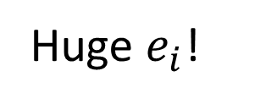
Problem 1: Linear LS with vertical data
Near vertical data is hard to fit since the error is computed perpendicular to x axis- the bigger the error, the bigger the error squared! (more weight for this datapoint).
Proposed solutions?
Huge $e_{i}$!

Slide 31
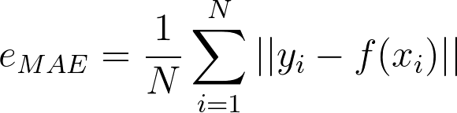
Problem 1: Linear LS with vertical data
One possible solution is making all errors weigh the same (and not squared). This will make the far points have the same impact on error as closer points. One such error MAE (mean absolute error, also known as L1 loss) instead of MSE.
The derivation of MAE is out of the class scope, but some details can be found here.
Another possible solution is computing the error distance of each point in a different way- one that takes into account the y data as well. One such algorithm is linear total least squares.
Notes:
e_{MAE}=\frac{1}{N}\sum_{i=1}^{N} ||y_i-f(x_i)||

Slide 32
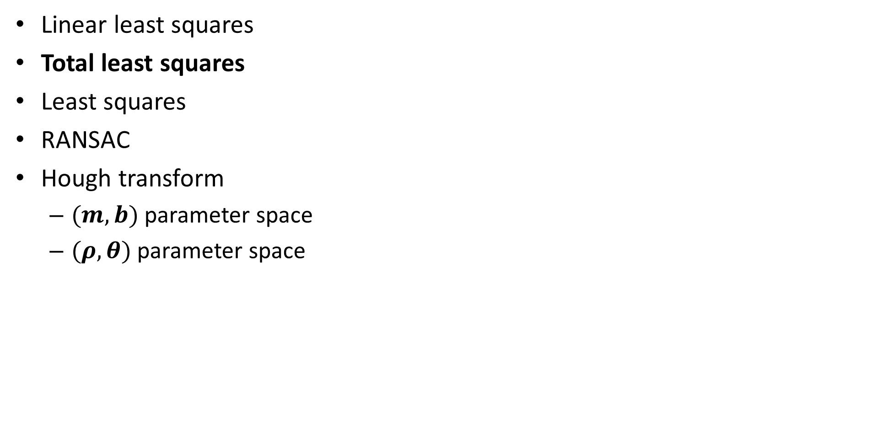
TOC
Linear least squares
Total least squares
Least squares
RANSAC
Hough transform
$(m,b)$ parameter space
$(ρ,θ)$ parameter space

Slide 33
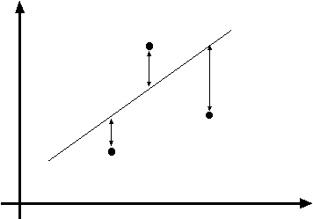
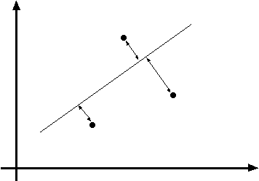
Line fitting- linear total least squares

Slide 34
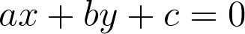
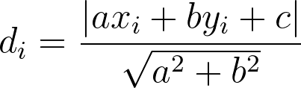
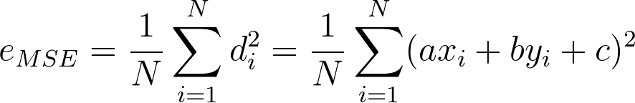
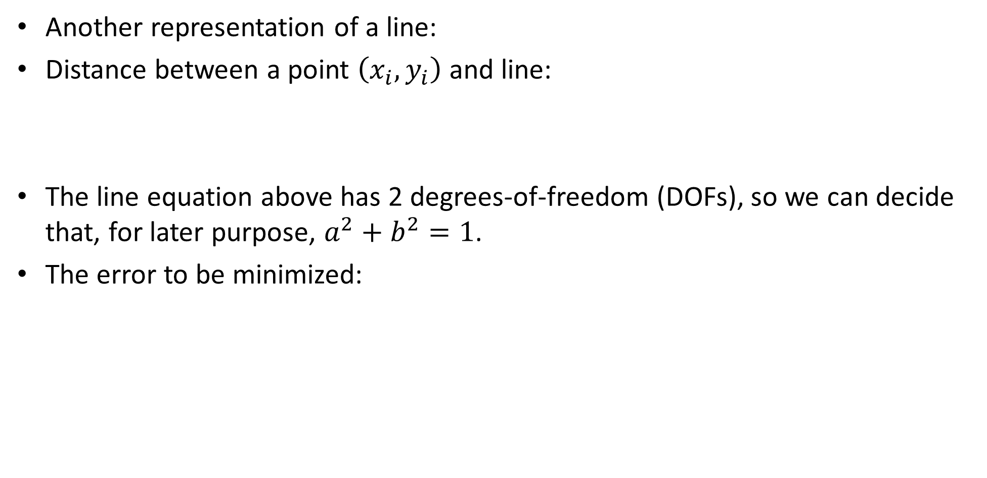
Line fitting- Line fitting- Linear TLS
Another representation of a line:
Distance between a point $\left(x_{i},y_{i}\right)$ and line:
The line equation above has 2 degrees-of-freedom (DOFs), so we can decide that, for later purpose, $a^{2}+b^{2}=1$.
The error to be minimized:
Notes:
ax+by+c=0
d_i = \frac{|ax_i+by_i+c|}{\sqrt{a^2+b^2}}
e_{MSE}=\frac{1}{N}\sum_{i=1}^{N}d_i^2=\frac{1}{N}\sum_{i=1}^{N} (ax_i+by_i+c)^2

Slide 35
Line fitting- Linear TLS
Another representation of a line:
Distance between a point $\left(x_{i},y_{i}\right)$ and line:
The line equation above has 2 degrees-of-freedom (DOFs), so we can decide that, for later purpose, $a^{2}+b^{2}=1$.
The error to be minimized:
Notes:
ax+by+c=0
d_i = \frac{|ax_i+by_i+c|}{\sqrt{a^2+b^2}}
e_{MSE}=\frac{1}{N}\sum_{i=1}^{N}d_i^2=\frac{1}{N}\sum_{i=1}^{N} (ax_i+by_i+c)^2

Slide 36
Line fitting- Linear TLS
Another representation of a line:
Distance between a point $\left(x_{i},y_{i}\right)$ and line:
The line equation above has 2 degrees-of-freedom (DOFs), so we can decide that, for later purpose, $a^{2}+b^{2}=1$.
The error to be minimized:
Notes:
ax+by+c=0
d_i = \frac{|ax_i+by_i+c|}{\sqrt{a^2+b^2}}
e_{MSE}=\frac{1}{N}\sum_{i=1}^{N}d_i^2=\frac{1}{N}\sum_{i=1}^{N} (ax_i+by_i+c)^2

Slide 37
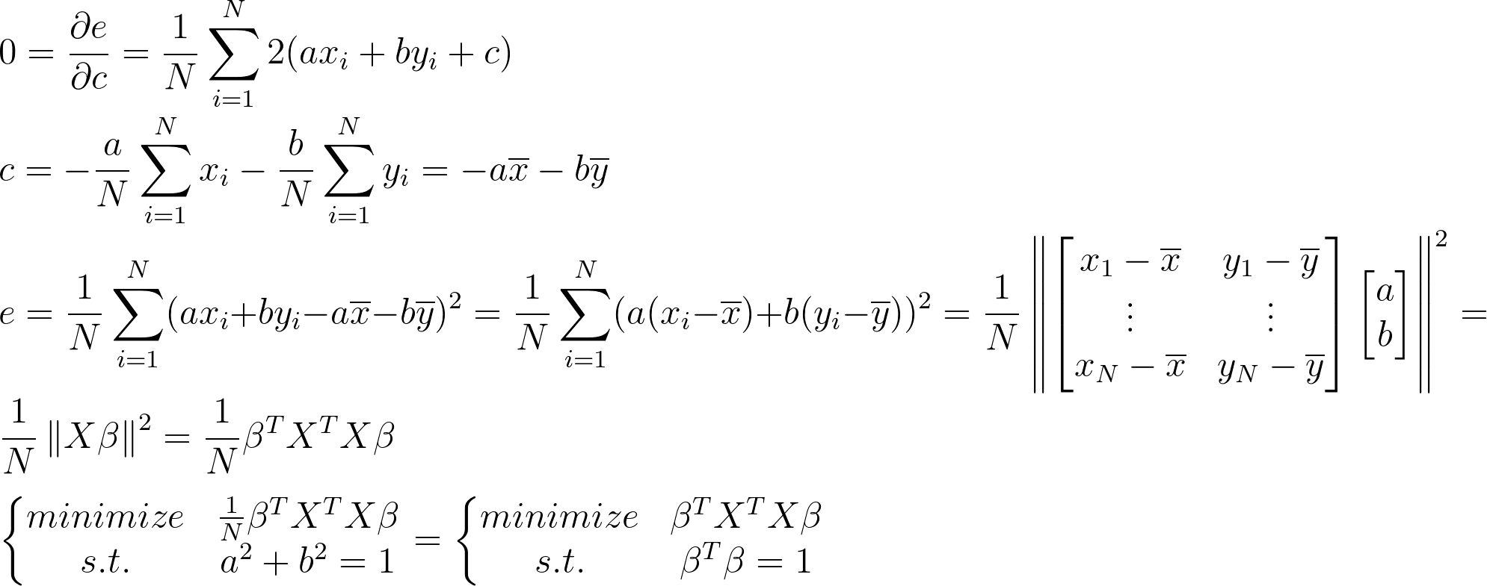
Line fitting- Linear TLS
Notes:
\\
0=\frac{\partial e}{\partial c} = \frac{1}{N}\sum_{i=1}^{N}2(ax_i+by_i+c)\\
c=-\frac{a}{N}\sum_{i=1}^{N}x_i-\frac{b}{N}\sum_{i=1}^{N}y_i=-a\overline{x}-b\overline{y}\\
e=\frac{1}{N}\sum_{i=1}^{N} (ax_i+by_i-a\overline{x}-b\overline{y})^2=\frac{1}{N}\sum_{i=1}^{N} (a(x_i-\overline{x})+b(y_i-\overline{y}))^2=
\frac{1}{N}\left \|
\begin{bmatrix}
x_1-\overline{x}&y_1-\overline{y}\\
\vdots&\vdots\\
x_N-\overline{x}&y_N-\overline{y}
\end{bmatrix}
\begin{bmatrix}
a\\
b
\end{bmatrix}
\right \|^2=
\\
\frac{1}{N}\left \|
X\beta
\right \|^2= \frac{1}{N}\beta^TX^TX\beta\\
\\
\left\{\begin{matrix}
minimize & \frac{1}{N}\beta^TX^TX\beta\\
s.t. & a^2+b^2=1
\end{matrix}\right.
=
\left\{\begin{matrix}
minimize & \beta^TX^TX\beta\\
s.t. & \beta^T\beta=1
\end{matrix}\right.

Slide 38
Line fitting- Linear TLS
Notes:
\\
0=\frac{\partial e}{\partial c} = \frac{1}{N}\sum_{i=1}^{N}2(ax_i+by_i+c)\\
c=-\frac{a}{N}\sum_{i=1}^{N}x_i-\frac{b}{N}\sum_{i=1}^{N}y_i=-a\overline{x}-b\overline{y}\\
e=\frac{1}{N}\sum_{i=1}^{N} (ax_i+by_i-a\overline{x}-b\overline{y})^2=\frac{1}{N}\sum_{i=1}^{N} (a(x_i-\overline{x})+b(y_i-\overline{y}))^2=
\frac{1}{N}\left \|
\begin{bmatrix}
x_1-\overline{x}&y_1-\overline{y}\\
\vdots&\vdots\\
x_N-\overline{x}&y_N-\overline{y}
\end{bmatrix}
\begin{bmatrix}
a\\
b
\end{bmatrix}
\right \|^2=
\\
\frac{1}{N}\left \|
X\beta
\right \|^2= \frac{1}{N}\beta^TX^TX\beta\\
\\
\left\{\begin{matrix}
minimize & \frac{1}{N}\beta^TX^TX\beta\\
s.t. & a^2+b^2=1
\end{matrix}\right.
=
\left\{\begin{matrix}
minimize & \beta^TX^TX\beta\\
s.t. & \beta^T\beta=1
\end{matrix}\right.

Slide 39
Line fitting- Linear TLS
Notes:
\\
0=\frac{\partial e}{\partial c} = \frac{1}{N}\sum_{i=1}^{N}2(ax_i+by_i+c)\\
c=-\frac{a}{N}\sum_{i=1}^{N}x_i-\frac{b}{N}\sum_{i=1}^{N}y_i=-a\overline{x}-b\overline{y}\\
e=\frac{1}{N}\sum_{i=1}^{N} (ax_i+by_i-a\overline{x}-b\overline{y})^2=\frac{1}{N}\sum_{i=1}^{N} (a(x_i-\overline{x})+b(y_i-\overline{y}))^2=
\frac{1}{N}\left \|
\begin{bmatrix}
x_1-\overline{x}&y_1-\overline{y}\\
\vdots&\vdots\\
x_N-\overline{x}&y_N-\overline{y}
\end{bmatrix}
\begin{bmatrix}
a\\
b
\end{bmatrix}
\right \|^2=
\\
\frac{1}{N}\left \|
X\beta
\right \|^2= \frac{1}{N}\beta^TX^TX\beta\\
\\
\left\{\begin{matrix}
minimize & \frac{1}{N}\beta^TX^TX\beta\\
s.t. & a^2+b^2=1
\end{matrix}\right.
=
\left\{\begin{matrix}
minimize & \beta^TX^TX\beta\\
s.t. & \beta^T\beta=1
\end{matrix}\right.

Slide 40
Line fitting- Linear TLS
Notes:
\\
0=\frac{\partial e}{\partial c} = \frac{1}{N}\sum_{i=1}^{N}2(ax_i+by_i+c)\\
c=-\frac{a}{N}\sum_{i=1}^{N}x_i-\frac{b}{N}\sum_{i=1}^{N}y_i=-a\overline{x}-b\overline{y}\\
e=\frac{1}{N}\sum_{i=1}^{N} (ax_i+by_i-a\overline{x}-b\overline{y})^2=\frac{1}{N}\sum_{i=1}^{N} (a(x_i-\overline{x})+b(y_i-\overline{y}))^2=
\frac{1}{N}\left \|
\begin{bmatrix}
x_1-\overline{x}&y_1-\overline{y}\\
\vdots&\vdots\\
x_N-\overline{x}&y_N-\overline{y}
\end{bmatrix}
\begin{bmatrix}
a\\
b
\end{bmatrix}
\right \|^2=
\\
\frac{1}{N}\left \|
X\beta
\right \|^2= \frac{1}{N}\beta^TX^TX\beta\\
\\
\left\{\begin{matrix}
minimize & \frac{1}{N}\beta^TX^TX\beta\\
s.t. & a^2+b^2=1
\end{matrix}\right.
=
\left\{\begin{matrix}
minimize & \beta^TX^TX\beta\\
s.t. & \beta^T\beta=1
\end{matrix}\right.

Slide 41
Line fitting- Linear TLS
Notes:
\\
0=\frac{\partial e}{\partial c} = \frac{1}{N}\sum_{i=1}^{N}2(ax_i+by_i+c)\\
c=-\frac{a}{N}\sum_{i=1}^{N}x_i-\frac{b}{N}\sum_{i=1}^{N}y_i=-a\overline{x}-b\overline{y}\\
e=\frac{1}{N}\sum_{i=1}^{N} (ax_i+by_i-a\overline{x}-b\overline{y})^2=\frac{1}{N}\sum_{i=1}^{N} (a(x_i-\overline{x})+b(y_i-\overline{y}))^2=
\frac{1}{N}\left \|
\begin{bmatrix}
x_1-\overline{x}&y_1-\overline{y}\\
\vdots&\vdots\\
x_N-\overline{x}&y_N-\overline{y}
\end{bmatrix}
\begin{bmatrix}
a\\
b
\end{bmatrix}
\right \|^2=
\\
\frac{1}{N}\left \|
X\beta
\right \|^2= \frac{1}{N}\beta^TX^TX\beta\\
\\
\left\{\begin{matrix}
minimize & \frac{1}{N}\beta^TX^TX\beta\\
s.t. & a^2+b^2=1
\end{matrix}\right.
=
\left\{\begin{matrix}
minimize & \beta^TX^TX\beta\\
s.t. & \beta^T\beta=1
\end{matrix}\right.

Slide 42
Line fitting- Linear TLS
Notes:
\\
0=\frac{\partial e}{\partial c} = \frac{1}{N}\sum_{i=1}^{N}2(ax_i+by_i+c)\\
c=-\frac{a}{N}\sum_{i=1}^{N}x_i-\frac{b}{N}\sum_{i=1}^{N}y_i=-a\overline{x}-b\overline{y}\\
e=\frac{1}{N}\sum_{i=1}^{N} (ax_i+by_i-a\overline{x}-b\overline{y})^2=\frac{1}{N}\sum_{i=1}^{N} (a(x_i-\overline{x})+b(y_i-\overline{y}))^2=
\frac{1}{N}\left \|
\begin{bmatrix}
x_1-\overline{x}&y_1-\overline{y}\\
\vdots&\vdots\\
x_N-\overline{x}&y_N-\overline{y}
\end{bmatrix}
\begin{bmatrix}
a\\
b
\end{bmatrix}
\right \|^2=
\\
\frac{1}{N}\left \|
X\beta
\right \|^2= \frac{1}{N}\beta^TX^TX\beta\\
\\
\left\{\begin{matrix}
minimize & \frac{1}{N}\beta^TX^TX\beta\\
s.t. & a^2+b^2=1
\end{matrix}\right.
=
\left\{\begin{matrix}
minimize & \beta^TX^TX\beta\\
s.t. & \beta^T\beta=1
\end{matrix}\right.

Slide 43
Line fitting- Linear TLS
Notes:
\\
0=\frac{\partial e}{\partial c} = \frac{1}{N}\sum_{i=1}^{N}2(ax_i+by_i+c)\\
c=-\frac{a}{N}\sum_{i=1}^{N}x_i-\frac{b}{N}\sum_{i=1}^{N}y_i=-a\overline{x}-b\overline{y}\\
e=\frac{1}{N}\sum_{i=1}^{N} (ax_i+by_i-a\overline{x}-b\overline{y})^2=\frac{1}{N}\sum_{i=1}^{N} (a(x_i-\overline{x})+b(y_i-\overline{y}))^2=
\frac{1}{N}\left \|
\begin{bmatrix}
x_1-\overline{x}&y_1-\overline{y}\\
\vdots&\vdots\\
x_N-\overline{x}&y_N-\overline{y}
\end{bmatrix}
\begin{bmatrix}
a\\
b
\end{bmatrix}
\right \|^2=
\\
\frac{1}{N}\left \|
X\beta
\right \|^2= \frac{1}{N}\beta^TX^TX\beta\\
\\
\left\{\begin{matrix}
minimize & \frac{1}{N}\beta^TX^TX\beta\\
s.t. & a^2+b^2=1
\end{matrix}\right.
=
\left\{\begin{matrix}
minimize & \beta^TX^TX\beta\\
s.t. & \beta^T\beta=1
\end{matrix}\right.

Slide 44
Line fitting- Linear TLS
Notes:
\\
0=\frac{\partial e}{\partial c} = \frac{1}{N}\sum_{i=1}^{N}2(ax_i+by_i+c)\\
c=-\frac{a}{N}\sum_{i=1}^{N}x_i-\frac{b}{N}\sum_{i=1}^{N}y_i=-a\overline{x}-b\overline{y}\\
e=\frac{1}{N}\sum_{i=1}^{N} (ax_i+by_i-a\overline{x}-b\overline{y})^2=\frac{1}{N}\sum_{i=1}^{N} (a(x_i-\overline{x})+b(y_i-\overline{y}))^2=
\frac{1}{N}\left \|
\begin{bmatrix}
x_1-\overline{x}&y_1-\overline{y}\\
\vdots&\vdots\\
x_N-\overline{x}&y_N-\overline{y}
\end{bmatrix}
\begin{bmatrix}
a\\
b
\end{bmatrix}
\right \|^2=
\\
\frac{1}{N}\left \|
X\beta
\right \|^2= \frac{1}{N}\beta^TX^TX\beta\\
\\
\left\{\begin{matrix}
minimize & \frac{1}{N}\beta^TX^TX\beta\\
s.t. & a^2+b^2=1
\end{matrix}\right.
=
\left\{\begin{matrix}
minimize & \beta^TX^TX\beta\\
s.t. & \beta^T\beta=1
\end{matrix}\right.

Slide 45
Line fitting- Linear TLS
Notes:
\\
0=\frac{\partial e}{\partial c} = \frac{1}{N}\sum_{i=1}^{N}2(ax_i+by_i+c)\\
c=-\frac{a}{N}\sum_{i=1}^{N}x_i-\frac{b}{N}\sum_{i=1}^{N}y_i=-a\overline{x}-b\overline{y}\\
e=\frac{1}{N}\sum_{i=1}^{N} (ax_i+by_i-a\overline{x}-b\overline{y})^2=\frac{1}{N}\sum_{i=1}^{N} (a(x_i-\overline{x})+b(y_i-\overline{y}))^2=
\frac{1}{N}\left \|
\begin{bmatrix}
x_1-\overline{x}&y_1-\overline{y}\\
\vdots&\vdots\\
x_N-\overline{x}&y_N-\overline{y}
\end{bmatrix}
\begin{bmatrix}
a\\
b
\end{bmatrix}
\right \|^2=
\\
\frac{1}{N}\left \|
X\beta
\right \|^2= \frac{1}{N}\beta^TX^TX\beta\\
\\
\left\{\begin{matrix}
minimize & \frac{1}{N}\beta^TX^TX\beta\\
s.t. & a^2+b^2=1
\end{matrix}\right.
=
\left\{\begin{matrix}
minimize & \beta^TX^TX\beta\\
s.t. & \beta^T\beta=1
\end{matrix}\right.
or
\left\{\begin{matrix}
minimize & ||X\beta||^2\\
s.t. & ||\beta||^2=1
\end{matrix}\right.

Slide 46
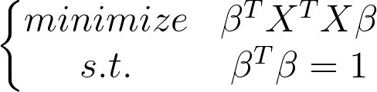
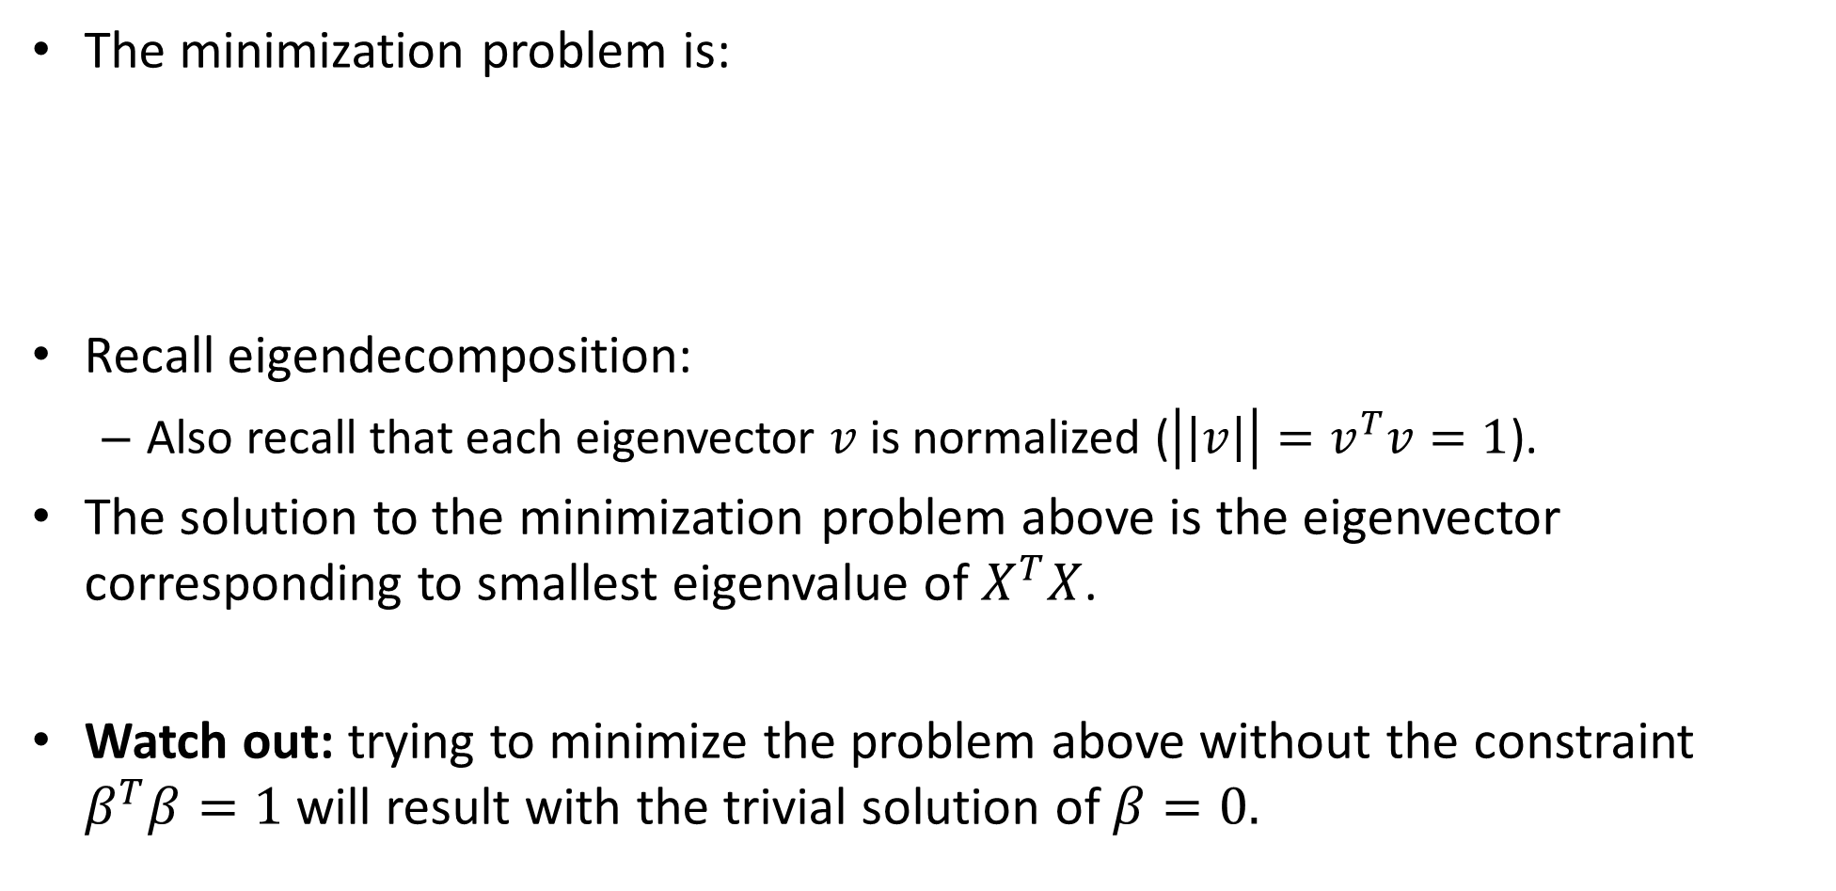
Line fitting- Linear TLS -the minimization problem
The minimization problem is:
Recall eigendecomposition:
Also recall that each eigenvector $v$is normalized ($\left|\left|v\right|\right|=v^{T}v=1$).
The solution to the minimization problem above is the eigenvector corresponding to smallest eigenvalue of $X^{T}X$.
Watch out: trying to minimize the problem above without the constraint $β^{T}β=1$ will result with the trivial solution of $β=0.$
Notes:
Av = \lambda v \mapsto v^TAv = \lambda

Slide 47
Line fitting- Linear TLS with SVD
Another similar way to solve this problem is using SVD, but it’s out of scope…
You can check the derivation out in: http://cmp.felk.cvut.cz/cmp/courses/XE33PVR/WS20072008/Lectures/Supporting/constrained_lsq.pdf
Read more about SVD decomposition here: https://en.wikipedia.org/wiki/Singular_value_decomposition

Slide 48
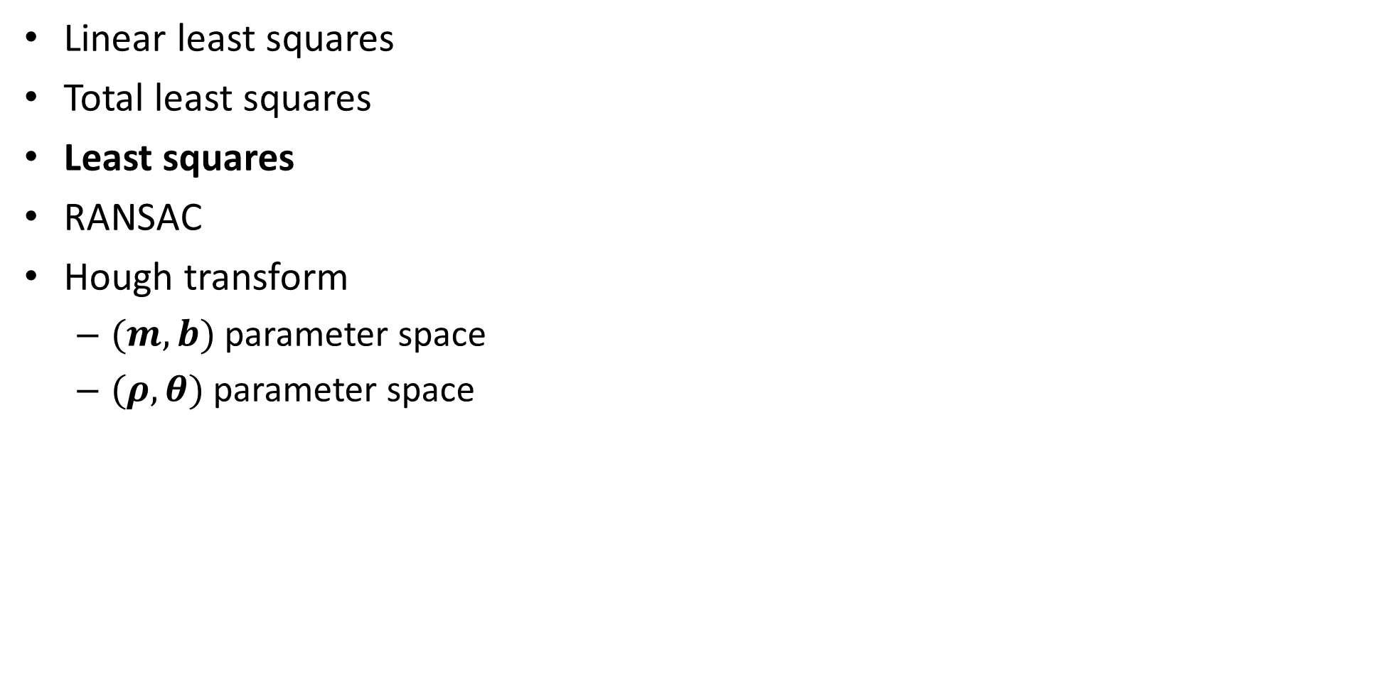
TOC
Linear least squares
Total least squares
Least squares
RANSAC
Hough transform
$(m,b)$ parameter space
$(ρ,θ)$ parameter space

Slide 49
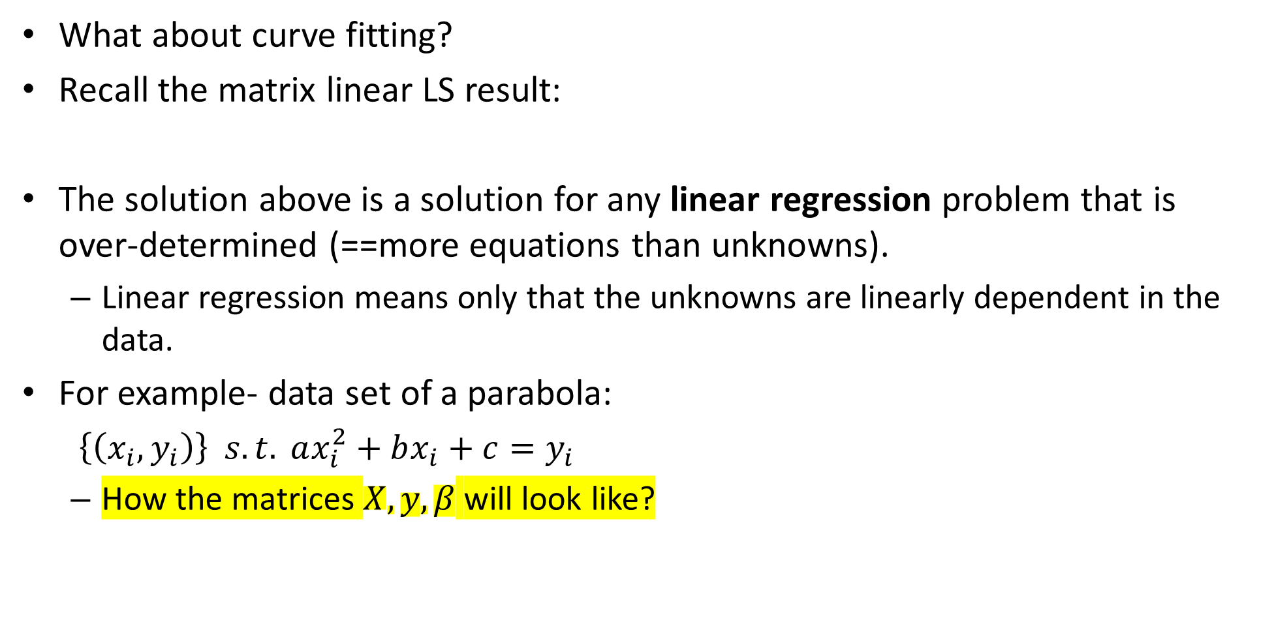
linear LS
What about curve fitting?
Recall the matrix linear LS result:
The solution above is a solution for any linear regression problem that is over-determined (==more equations than unknowns).
Linear regression means only that the unknowns are linearly dependent in the data.
For example- data set of a parabola:
$\left\{\left(x_{i},y_{i}\right)\right\} s.t. ax_{i}^{2}+bx_{i}+c=y_{i}$
How the matrices $X,y,β$ will look like?
Notes:
\beta = (X^TX+\epsilon I)^{-1}X^Ty
y =
\begin{bmatrix}
y_1\\
\vdots\\
y_N
\end{bmatrix}
\,\,\,
X=
\begin{bmatrix}
x_1^2&x_1&1\\
\vdots&\vdots&\vdots\\
x_N^2&x_N&1
\end{bmatrix}
\,\,\,
\beta=
\begin{bmatrix}
a\\
b\\
c
\end{bmatrix}

Slide 50
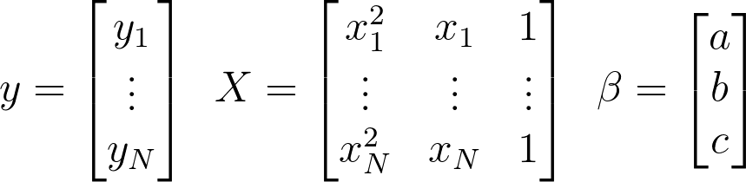
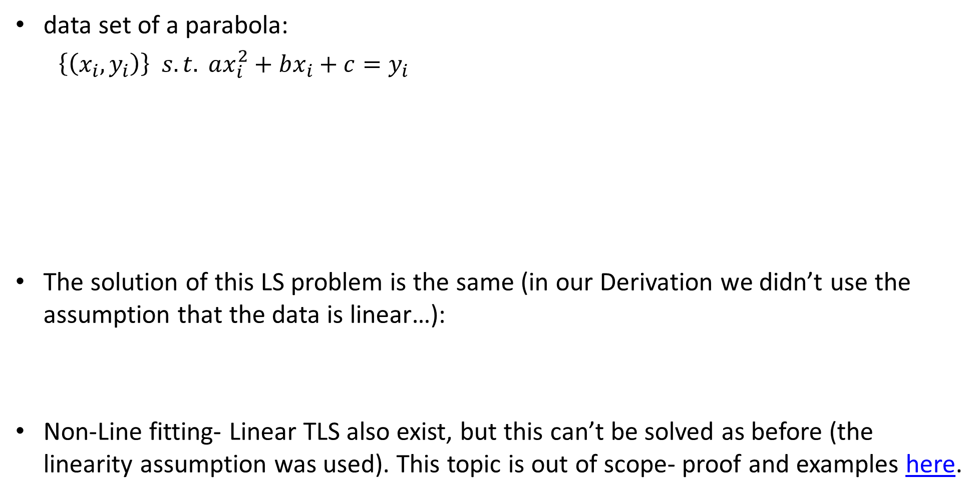
LS
data set of a parabola:
$\left\{\left(x_{i},y_{i}\right)\right\} s.t. ax_{i}^{2}+bx_{i}+c=y_{i}$
The solution of this LS problem is the same (in our Derivation we didn’t use the assumption that the data is linear…):
Non-Line fitting- Linear TLS also exist, but this can’t be solved as before (the linearity assumption was used). This topic is out of scope- proof and examples here.
Notes:
y =
\begin{bmatrix}
y_1\\
\vdots\\
y_N
\end{bmatrix}
\,\,\,
X=
\begin{bmatrix}
x_1^2&x_1&1\\
\vdots&\vdots&\vdots\\
x_N^2&x_N&1
\end{bmatrix}
\,\,\,
\beta=
\begin{bmatrix}
a\\
b\\
c
\end{bmatrix}

Slide 51
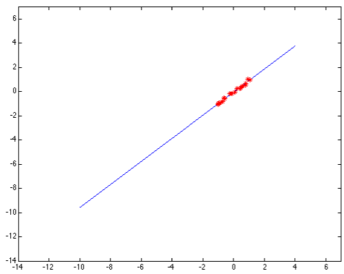
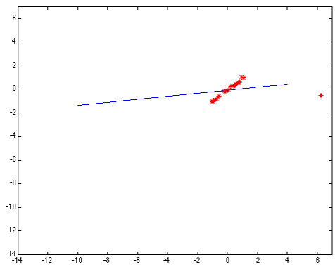
Problem 2: LS with outliers datapoints
Outlier: a data point that differs significantly from other observations. [Wikipedia]
Least-squares error fit
Squared error heavily penalizes outliers

Slide 52
Problem 2: LS with outliers datapoints
One possible solution: MAE (again)- for less penalization on outliers.
A better solution: removing the outliers! Possible algorithm to use: RANSAC

Slide 53
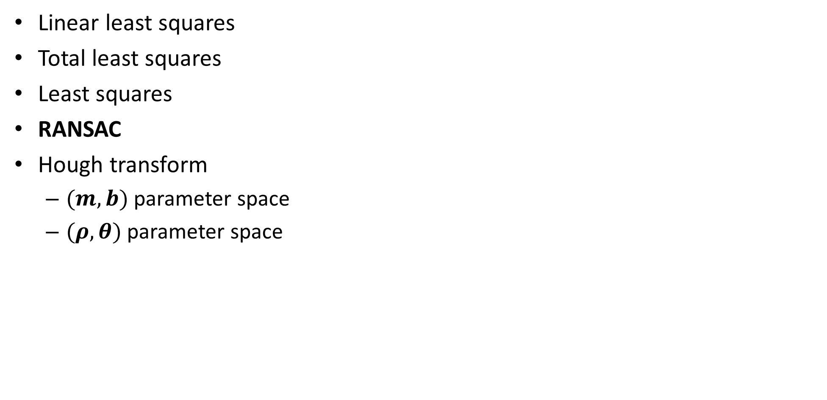
TOC
Linear least squares
Total least squares
Least squares
RANSAC
Hough transform
$(m,b)$ parameter space
$(ρ,θ)$ parameter space

Slide 54
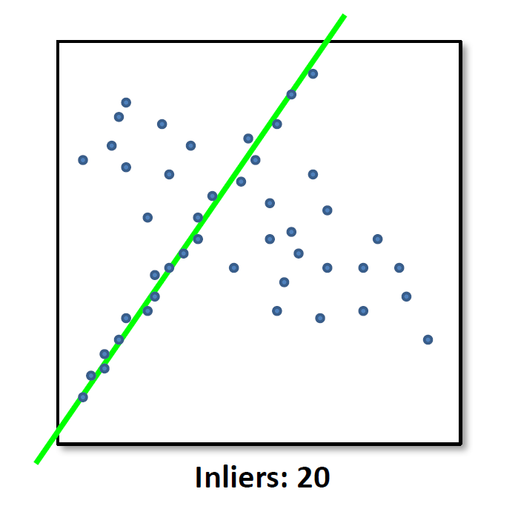
RANSAC
Random sample consensus (RANSAC) is an iterative method to estimate parameters of a mathematical model from a set of observed data that contains outliers. [Wikipedia]

Slide 55
RANSAC algorithm
While searching for best model fit:
Select a random subset of the original data.
Fit a model to the data subset.
find inliers that fit the given model.
if number_inliers is bigger than the old best model number_inliers:
Save as best model

Slide 56
RANSAC algorithm - step by step - 1
Select a random subset of the original data.
The number of samples in the subset is the smallest needed to determine the model parameters (== number of unknow variables).
Examples:
For line fit- only 2 datapoints.
For parabola fit- 3 datapoints.

Slide 57
RANSAC algorithm - step by step - 2
Fit a model to the data subset.
Can be done using a chosen algorithm (for example LS).

Slide 58
RANSAC algorithm - step by step - 3
find inliers that fit the given model.
Test all dataset against the fitted model. Points that fit the estimated model well, according to some chosen loss function, are considered as part of the consensus set. This points are called inliers.
A possible loss function is MSE of the distances (same as TLS).
Choose a threshold for the error: below this TH the datapoint will be consider as an inlier.
TH

Slide 59
RANSAC algorithm - step by step - 4
if number_inliers is bigger than the old best model number_inliers:
Save as best model
Trivial…
An improvement to the final step can be iteratively re-fitting the model with all inliers to find a better describing model.

Slide 60
RANSAC algorithm - step by step - 0
While searching for best model fit:
How do we know when to stop? How much we need to iterate before getting the best model?
Let’s look at a possible statistical model for this question.

Slide 61
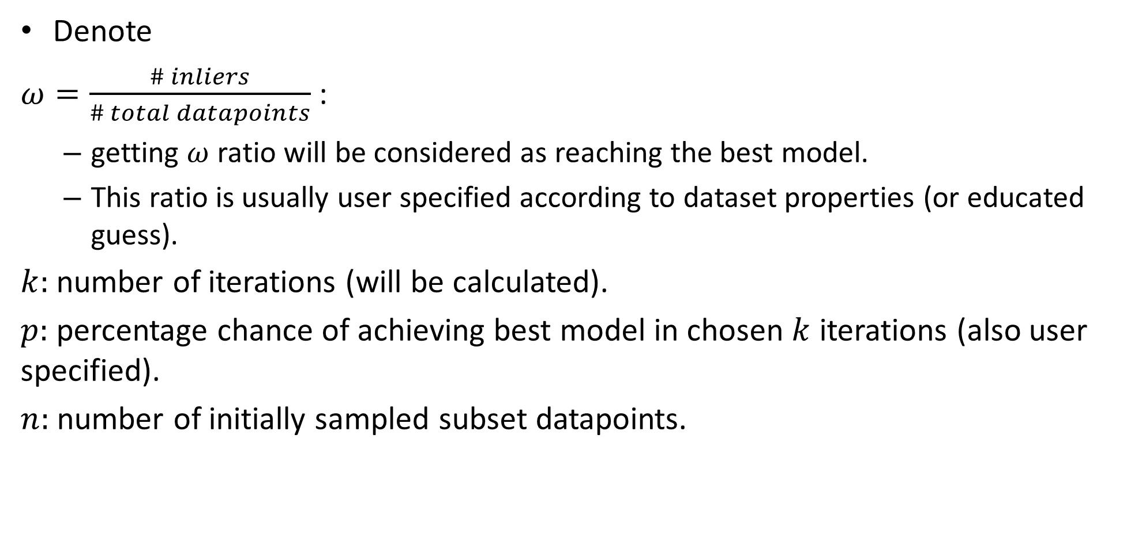
RANSAC convergence
Denote
$ω=\frac{\# inliers}{\# total datapoints}$ :
getting $ω$ ratio will be considered as reaching the best model.
This ratio is usually user specified according to dataset properties (or educated guess).
$k:$ number of iterations (will be calculated).
$p:$ percentage chance of achieving best model in chosen $k$ iterations (also user specified).
$n:$ number of initially sampled subset datapoints.

Slide 62
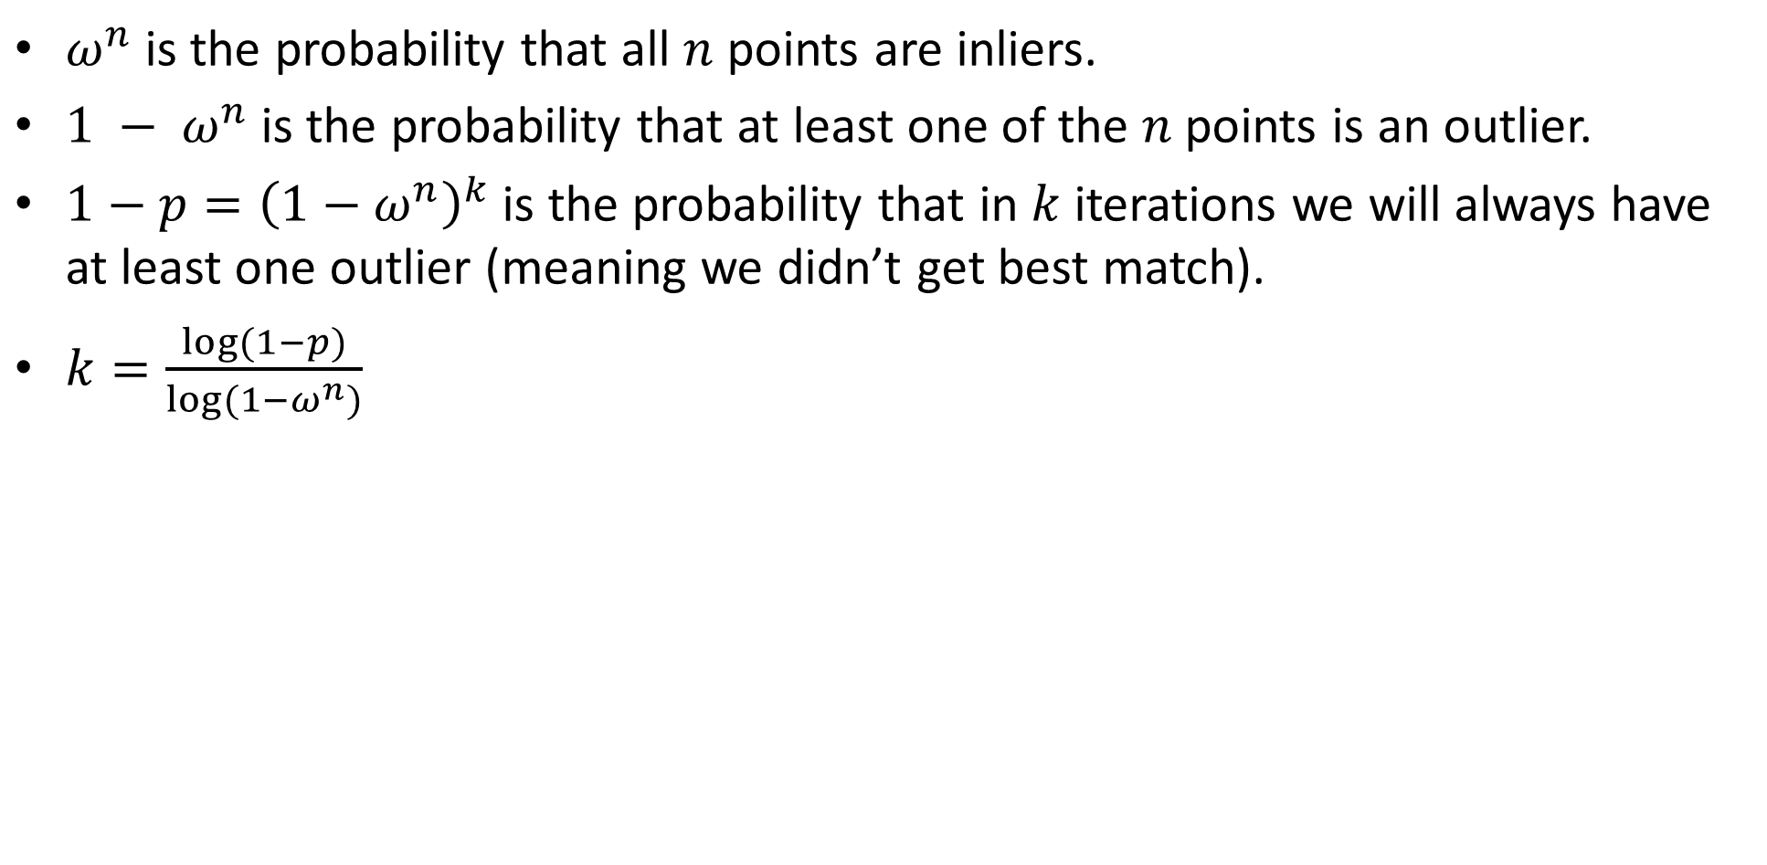
RANSAC convergence
$ω^{n}$is the probability that all $n$ points are inliers.
$1 − ω^{n}$is the probability that at least one of the $n$points is an outlier.
$1−p={\left(1−ω^{n}\right)}^{k}$ is the probability that in $k$ iterations we will always have at least one outlier (meaning we didn’t get best match).
$k=\frac{log⁡(1−p)}{log⁡(1−ω^{n})}$

Slide 63
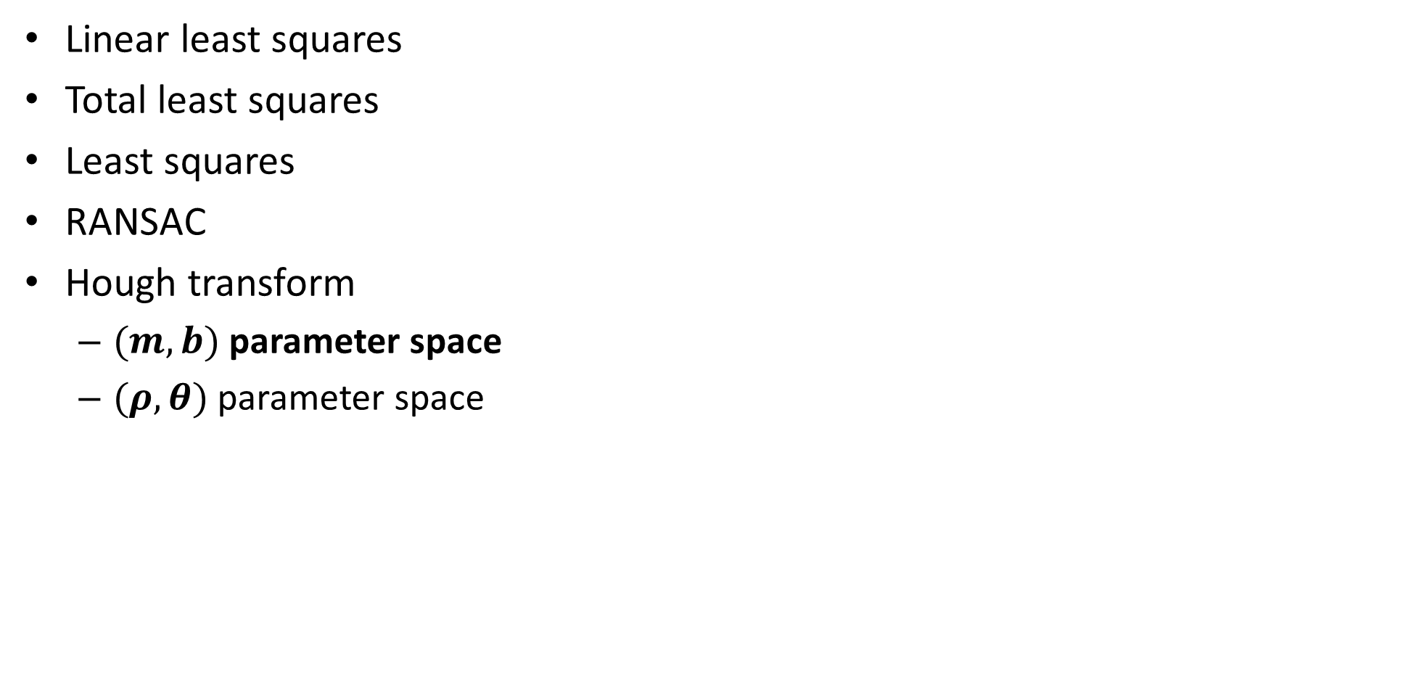
TOC
Linear least squares
Total least squares
Least squares
RANSAC
Hough transform
$(m,b)$ parameter space
$(ρ,θ)$ parameter space

Slide 64
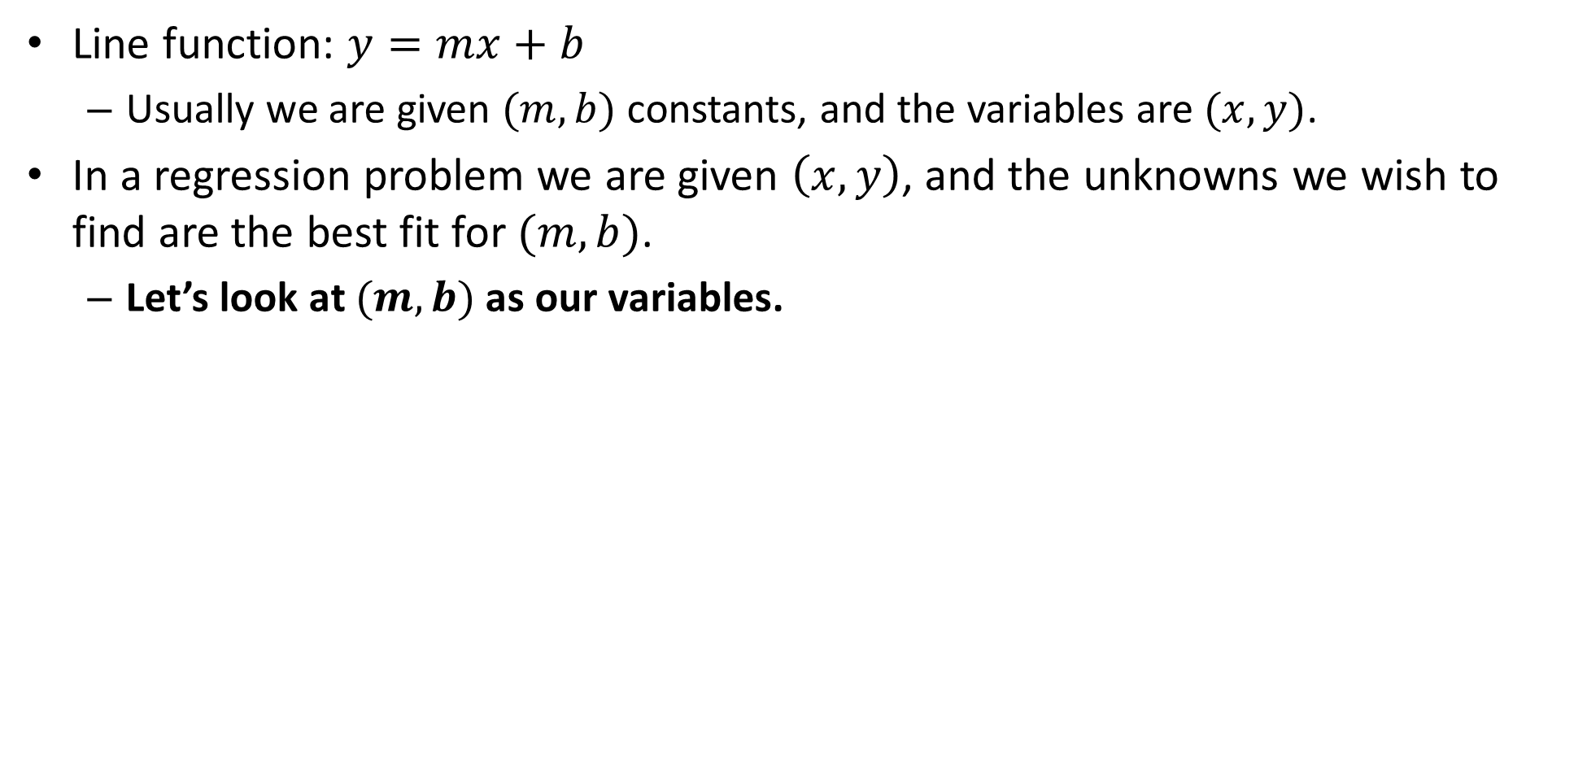
$(m,b)$ Parameter space
Line function: $y=mx+b$
Usually we are given $(m,b)$ constants, and the variables are $(x,y)$.
In a regression problem we are given $\left(x,y\right)$, and the unknowns we wish to find are the best fit for $(m,b)$.
Let’s look at $(m,b)$ as our variables.

Slide 65
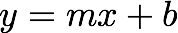
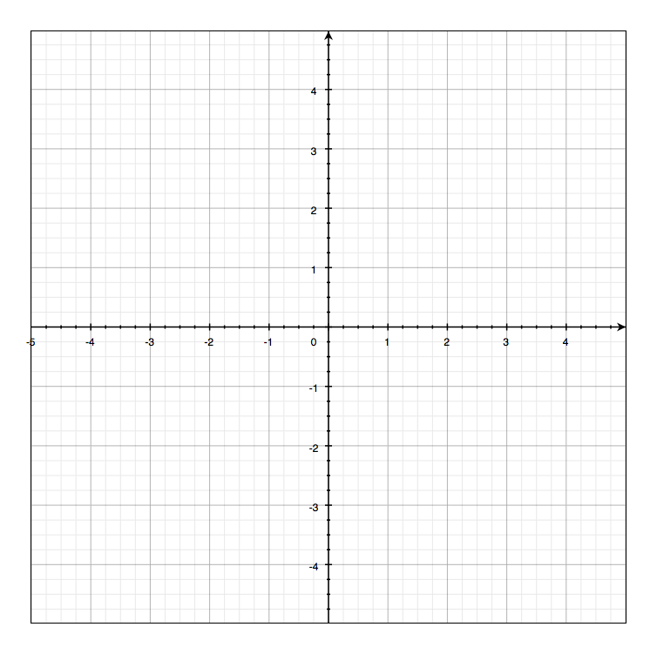

$(m,b)$ Parameter space
variables
parameters
Let’s look at $(m,b)$ as our variables
Image space
Plots are from: http://www.cs.cmu.edu/~16385/

Slide 66


$(m,b)$ Parameter space
variables
variables
parameters
parameters
a line becomes a point
Image space
Parameter space

Slide 67
$(m,b)$ Parameter space
variables
parameters
a point becomes a ?
Image space

Slide 68
$(m,b)$ Parameter space
variables
variables
parameters
parameters
a point becomes a ?
Image space
Parameter space

Slide 69
$(m,b)$ Parameter space
variables
variables
parameters
parameters
a point becomes a ?
Image space
Parameter space

Slide 70
$(m,b)$ Parameter space
variables
variables
parameters
parameters
a point becomes a ?
Image space
Parameter space

Slide 71
$(m,b)$ Parameter space
variables
variables
parameters
parameters
a point becomes a line
Image space
Parameter space

Slide 72

$(m,b)$ Parameter space
variables
variables
parameters
parameters
two points become
?
Image space
Parameter space

Slide 73
$(m,b)$ Parameter space
variables
variables
parameters
parameters
two points become
Two lines
Image space
Parameter space

Slide 74

$(m,b)$ Parameter space
variables
variables
parameters
parameters
three points become
?
Image space
Parameter space

Slide 75
$(m,b)$ Parameter space
variables
variables
parameters
parameters
three points become
Three lines
Image space
Parameter space

Slide 76

$(m,b)$ Parameter space
variables
variables
parameters
parameters
four points become
?
Image space
Parameter space

Slide 77
$(m,b)$ Parameter space
variables
variables
parameters
parameters
four points become
Four lines
Image space
Parameter space

Slide 78
Parameter space- what for?
How can we find lines in dataset using the parameter space?

Slide 79
Parameter space- what for?
How can we find lines in dataset using the parameter space?
1. Quantize the output parameter space to user defined bins- we will call this table the accumulator table.
Image space
Parameter space

Slide 80
Parameter space- what for?
How can we find lines in dataset using the parameter space?
2. For each point in image space- find corresponding line in parameter space and increment +1 the intersecting bins.
1
1
1
1
1
1
1
1
Image space
Parameter space

Slide 81
Parameter space- what for?
How can we find lines in dataset using the parameter space?
2. For each point in image space- find corresponding line in parameter space and increment +1 the intersecting bins.
1
1
1
1
1
1
1
1
2
1
1
1
1
1
1
1
Image space
Parameter space

Slide 82
Parameter space- what for?
How can we find lines in dataset using the parameter space?
2. For each point in image space- find corresponding line in parameter space and increment +1 the intersecting bins.
1
1
1
1
1
1
1
1
1
1
2
1
3
1
2
1
1
1
1
1
1
1
1
1
1
Image space
Parameter space

Slide 83
Parameter space- what for?
How can we find lines in dataset using the parameter space?
2. For each point in image space- find corresponding line in parameter space and increment +1 the intersecting bins.
1
1
1
1
1
1
1
1
1
1
1
1
1
2
1
1
3
2
2
1
1
1
1
1
1
1
2
1
1
1
1
Image space
Parameter space

Slide 84
Parameter space- what for?
How can we find lines in dataset using the parameter space?
3. Threshold the accumulator table result by some TH and get the corresponding line parameters.
1
1
1
1
1
1
1
1
1
1
1
1
1
2
1
1
3
3
2
2
1
1
1
1
1
1
1
2
1
1
1
1
Image space
Parameter space

Slide 85
Hough transform
Build accumulator table.
For each point in image space:
find corresponding line in parameter space and increment +1 the intersecting bins.
Threshold the accumulator table result by some TH and get the corresponding line parameters.

Slide 86

Hough transform- pros & cons
Pros:
Can detect multiple lines in image space.
can be extended to detect different parameterized curves (e.g.: circles, ellipsoids), and even un-parameterized curves (generalized hough transform [out of scope]- similar to template matching that will be covered later in course).
Cons:
For the shown $(m,b)$ parameter space, can’t detect vertical lines. Why?
Susceptive to noise. Why?
Computationally costly.

Slide 87


Problem 1: vertical line detection
Vertical (or near vertical) lines have a big slope: $m→∞$. This causes the accumulator table to be very big in $m$ direction.
A solution is to give a different parameterization to lines:
Notes:
\\
y=mx+b\\
\xrightarrow{x=0}y=b\\
\xrightarrow{y=0}x=-\frac{b}{m}\\
\frac{\frac{-b}{m}}{b}=-\frac{1}{m}=tg\theta\rightarrow m=-\frac{1}{tg\theta}=-\frac{cos\theta}{sin\theta} \\
\frac{\rho}{b}=sin\theta\rightarrow b=\frac{\rho}{sin\theta}
\\
y=mx+b\rightarrow y=-\frac{cos\theta}{sin\theta}x+\frac{\rho}{sin\theta}
\rightarrow xcos\theta +ysin\theta = \rho

Slide 88
Problem 1: vertical line detection
Vertical (or near vertical) lines have a big slope: $m→∞$. This causes the accumulator table to be very big in $m$ direction.
A solution is to give a different parameterization to lines:
Notes:
\\
y=mx+b\\
\xrightarrow{x=0}y=b\\
\xrightarrow{y=0}x=-\frac{b}{m}\\
\frac{\frac{-b}{m}}{b}=-\frac{1}{m}=tg\theta\rightarrow m=-\frac{1}{tg\theta}=-\frac{cos\theta}{sin\theta} \\
\frac{\rho}{b}=sin\theta\rightarrow b=\frac{\rho}{sin\theta}
\\
y=mx+b\rightarrow y=-\frac{cos\theta}{sin\theta}x+\frac{\rho}{sin\theta}
\rightarrow xcos\theta +ysin\theta = \rho

Slide 89
Problem 1: vertical line detection
Vertical (or near vertical) lines have a big slope: $m→∞$. This causes the accumulator table to be very big in $m$ direction.
A solution is to give a different parameterization to lines:
Notes:
\\
y=mx+b\\
\xrightarrow{x=0}y=b\\
\xrightarrow{y=0}x=-\frac{b}{m}\\
\frac{\frac{-b}{m}}{b}=-\frac{1}{m}=tg\theta\rightarrow m=-\frac{1}{tg\theta}=-\frac{cos\theta}{sin\theta} \\
\frac{\rho}{b}=sin\theta\rightarrow b=\frac{\rho}{sin\theta}
\\
y=mx+b\rightarrow y=-\frac{cos\theta}{sin\theta}x+\frac{\rho}{sin\theta}
\rightarrow xcos\theta +ysin\theta = \rho

Slide 90
Problem 1: vertical line detection
Vertical (or near vertical) lines have a big slope: $m→∞$. This causes the accumulator table to be very big in $m$ direction.
A solution is to give a different parameterization to lines:
Notes:
\\
y=mx+b\\
\xrightarrow{x=0}y=b\\
\xrightarrow{y=0}x=-\frac{b}{m}\\
\frac{\frac{-b}{m}}{b}=-\frac{1}{m}=tg\theta\rightarrow m=-\frac{1}{tg\theta}=-\frac{cos\theta}{sin\theta} \\
\frac{\rho}{b}=sin\theta\rightarrow b=\frac{\rho}{sin\theta}
\\
y=mx+b\rightarrow y=-\frac{cos\theta}{sin\theta}x+\frac{\rho}{sin\theta}
\rightarrow xcos\theta +ysin\theta = \rho

Slide 91
Problem 1: vertical line detection
Vertical (or near vertical) lines have a big slope: $m→∞$. This causes the accumulator table to be very big in $m$ direction.
A solution is to give a different parameterization to lines:
Notes:
\\
y=mx+b\\
\xrightarrow{x=0}y=b\\
\xrightarrow{y=0}x=-\frac{b}{m}\\
\frac{\frac{-b}{m}}{b}=-\frac{1}{m}=tg\theta\rightarrow m=-\frac{1}{tg\theta}=-\frac{cos\theta}{sin\theta} \\
\frac{\rho}{b}=sin\theta\rightarrow b=\frac{\rho}{sin\theta}
\\
y=mx+b\rightarrow y=-\frac{cos\theta}{sin\theta}x+\frac{\rho}{sin\theta}
\rightarrow xcos\theta +ysin\theta = \rho

Slide 92
Problem 1: vertical line detection
Vertical (or near vertical) lines have a big slope: $m→∞$. This causes the accumulator table to be very big in $m$ direction.
A solution is to give a different parameterization to lines:
Notes:
\\
y=mx+b\\
\xrightarrow{x=0}y=b\\
\xrightarrow{y=0}x=-\frac{b}{m}\\
\frac{\frac{-b}{m}}{b}=-\frac{1}{m}=tg\theta\rightarrow m=-\frac{1}{tg\theta}=-\frac{cos\theta}{sin\theta} \\
\frac{\rho}{b}=sin\theta\rightarrow b=\frac{\rho}{sin\theta}
\\
y=mx+b\rightarrow y=-\frac{cos\theta}{sin\theta}x+\frac{\rho}{sin\theta}
\rightarrow xcos\theta +ysin\theta = \rho

Slide 93
Problem 1: vertical line detection
Vertical (or near vertical) lines have a big slope: $m→∞$. This causes the accumulator table to be very big in $m$ direction.
A solution is to give a different parameterization to lines:
Notes:
\\
y=mx+b\\
\xrightarrow{x=0}y=b\\
\xrightarrow{y=0}x=-\frac{b}{m}\\
\frac{\frac{-b}{m}}{b}=-\frac{1}{m}=tg\theta\rightarrow m=-\frac{1}{tg\theta}=-\frac{cos\theta}{sin\theta} \\
\frac{\rho}{b}=sin\theta\rightarrow b=\frac{\rho}{sin\theta}
\\
y=mx+b\rightarrow y=-\frac{cos\theta}{sin\theta}x+\frac{\rho}{sin\theta}
\rightarrow xcos\theta +ysin\theta = \rho

Slide 94
Problem 1: vertical line detection
Vertical (or near vertical) lines have a big slope: $m→∞$. This causes the accumulator table to be very big in $m$ direction.
A solution is to give a different parameterization to lines:
Notes:
\\
y=mx+b\\
\xrightarrow{x=0}y=b\\
\xrightarrow{y=0}x=-\frac{b}{m}\\
\frac{\frac{-b}{m}}{b}=-\frac{1}{m}=tg\theta\rightarrow m=-\frac{1}{tg\theta}=-\frac{cos\theta}{sin\theta} \\
\frac{\rho}{b}=sin\theta\rightarrow b=\frac{\rho}{sin\theta}
\\
y=mx+b\rightarrow y=-\frac{cos\theta}{sin\theta}x+\frac{\rho}{sin\theta}
\rightarrow xcos\theta +ysin\theta = \rho

Slide 95
Problem 1: vertical line detection
Vertical (or near vertical) lines have a big slope: $m→∞$. This causes the accumulator table to be very big in $m$ direction.
A solution is to give a different parameterization to lines:
Notes:
\\
y=mx+b\\
\xrightarrow{x=0}y=b\\
\xrightarrow{y=0}x=-\frac{b}{m}\\
\frac{\frac{-b}{m}}{b}=-\frac{1}{m}=tg\theta\rightarrow m=-\frac{1}{tg\theta}=-\frac{cos\theta}{sin\theta} \\
\frac{\rho}{b}=sin\theta\rightarrow b=\frac{\rho}{sin\theta}
\\
y=mx+b\rightarrow y=-\frac{cos\theta}{sin\theta}x+\frac{\rho}{sin\theta}
\rightarrow xcos\theta +ysin\theta = \rho

Slide 96

TOC
Linear least squares
Total least squares
Least squares
RANSAC
Hough transform
$(m,b)$ parameter space
$(ρ,θ)$ parameter space

Slide 97


$(ρ,θ)$ parameter space
variables
parameters
parameters
variables
a point becomes a wave
Image space
Parameter space

Slide 98
$(ρ,θ)$ parameter space
variables
parameters
a line
becomes a point
Image space
Parameter space

Slide 99
$(ρ,θ)$ parameter space
variables
parameters
a line
becomes a point
Image space
Parameter space

Slide 100
$(ρ,θ)$ parameter space
variables
parameters
a line
becomes a point
Image space
Parameter space

Slide 101
$(ρ,θ)$ parameter space
variables
parameters
a line
becomes a point
Image space
Parameter space

Slide 102
$(ρ,θ)$ parameter space
variables
parameters
a line
becomes a point
Image space
Parameter space

Slide 103

$(ρ,θ)$ parameter space
variables
parameters
$$ρ=−1$$
a line
becomes a point
Image space
Parameter space

Slide 104

Notes on $(ρ,θ)$ parameter space
We only care about $0≤θ<π$, otherwise it’s symmetric.
As we so earlier, for some $θ→sign\left(ρ\right)=−1$. this is acceptable since the derivation earlier was right only for the first quadrant.

Slide 105
$(ρ,θ)$ parameter space
variables
parameters
a point becomes a wave
Image space
Parameter space

Slide 106

$(ρ,θ)$ parameter space
variables
parameters
Image space
Parameter space

Slide 107

$(ρ,θ)$ parameter space
variables
parameters
Image space
Parameter space

Slide 108

$(ρ,θ)$ parameter space
variables
parameters
Image space
Parameter space

Slide 109
Hough transform algorithm stays the same!
Build accumulator table.
For each point in image space:
find corresponding line in parameter space and increment +1 the intersecting bins.
Threshold the accumulator table result by some TH and get the corresponding line parameters.

Slide 110

Hough transform- pros & cons
Pros:
Can detect multiple lines in image space.
can be extended to detect different parameterized curves (e.g.: circles, ellipsoids), and even un-parameterized curves (generalized hough transform [out of scope]- similar to template matching that will be covered later in course).
Cons:
For the shown $(m,b)$ parameter space, can’t detect vertical lines. Why?
Susceptive to noise. Why?
Computationally costly.

Slide 111

Hough transform noise
In case that the discovered edge is noisy, the binning process in the accumulation matrix can be problematic.
This is a known problem of Hough transform… some ways to get better results is to try:
Different bin size (different step size for $R \& θ$).
Smooth the accumulation matrix before thresholding.

